Slide 1

FlipRobo Technologies ; location : banglore
PROJEC T : Cause of death
SUBMITTED B Y : Jyoti Chaudhary
PROJEC T : C auses of death

Slide 2



ACKNOWLEDGEMENT:
These sites helped me to complete my project :

Slide 3

Business Problem framing:
A straightforward way to assess the health status of a population is to focus on mortality – or concepts like child mortality or life expectancy, which are based on mortality estimates. A focus on mortality, however, does not take into account that the burden of diseases is not only that they kill people, but that they cause suffering to people who live with them. Assessing health outcomes by both mortality and morbidity (the prevalent diseases) provides a more encompassing view on health outcomes. This is the topic of this entry. The sum of mortality and morbidity is referred to as the ‘burden of disease’ and can be measured by a metric called ‘Disability Adjusted Life Years‘ (DALYs). DALYs are measuring lost health and are a standardized metric that allow for direct comparisons of disease burdens of different diseases across countries, between different populations, and over time. Conceptually, one DALY is the equivalent of losing one year in good health because of either premature death or disease or disability. One DALY represents one lost year of healthy life. The first ‘Global Burden of Disease’ (GBD) was GBD 1990 and the DALY metric was prominently featured in the World Bank’s 1993 World Development Report. Today it is published by both the researchers at the Institute of Health Metrics and Evaluation (IHME) and the ‘Disease Burden Unit’ at the World Health Organization (WHO), which was created in 1998. The IHME continues the work that was started in the early 1990s and publishes the Global Burden of Disease study.

Slide 4
Attributes(Column-wise)
01. Country/Territory - Name of the Country/Territory
⦁ 02. Code - Country/Territory Code
⦁ 03. Year - Year of the Incident
⦁ 04. Meningitis - No. of People died from Meningitis
⦁ 05. Alzheimer's Disease and Other Dementias - No. of People died from Alzheimer's Disease and Other Dementias
⦁ 06. Parkinson's Disease - No. of People died from Parkinson's Disease
⦁ 07. Nutritional Deficiencies - No. of People died from Nutritional Deficiencies
⦁ 08. Malaria - No. of People died from Malaria
⦁ 09. Drowning - No. of People died from Drowning
⦁ 10. Interpersonal Violence - No. of People died from Inte
.11. Maternal Disorders - No. of People died from Maternal Disorders
⦁ 12. Drug Use Disorders - No. of People died from Drug Use Disorders
⦁ 13. Tuberculosis - No. of People died from Tuberculosis
⦁ 14. Cardiovascular Diseases - No. of People died from Cardiovascular Diseases
⦁ 15. Lower Respiratory Infections - No. of People died from Lower Respiratory Infections
⦁ 16. Neonatal Disorders - No. of People died from Neonatal Disorders
⦁ 17. Alcohol Use Disorders - No. of People died from Alcohol Use Disorders
⦁ 18. Self-harm - No. of People died from Self-harm
⦁ 19. Exposure to Forces of Nature - No. of People died from Exposure to Forces of Nature
⦁ 20. Diarrheal Diseases - No. of People died from Diarrheal Diseases
rpersonal Violence

Slide 5
Attributes(Column-wise)
⦁ 21. Environmental Heat and Cold Exposure - No. of People died from Environmental Heat and Cold Exposure
⦁ 22. Neoplasms - No. of People died from Neoplasms
⦁ 23. Conflict and Terrorism - No. of People died from Conflict and Terrorism
⦁ 24. Diabetes Mellitus - No. of People died from Diabetes Mellitus
⦁ 25. Chronic Kidney Disease - No. of People died from Chronic Kidney Disease
⦁ 26. Poisonings - No. of People died from Poisoning
⦁ 27. Protein-Energy Malnutrition - No. of People died from Protein-Energy Malnutrition
⦁ 28. Chronic Respiratory Diseases - No. of People died from Chronic Respiratory Diseases
⦁ 29. Cirrhosis and Other Chronic Liver Diseases - No. of People died from Cirrhosis and Other Chronic Liver Diseases
⦁ 30. Digestive Diseases - No. of People died from Digestive Diseases
⦁ 31. Fire, Heat, and Hot Substances - No. of People died from Fire or Heat or any Hot Substances
⦁ 32. Acute Hepatitis - No. of People died from Acute Hepatitis

Slide 6
Analytical problem framing Content:
In this Dataset, we have Historical Data of different cause of deaths for all ages around the World. The key features of this Dataset are: Meningitis, Alzheimer's Disease and Other Dementias, Parkinson's Disease, Nutritional Deficiencies, Malaria, Drowning, Interpersonal Violence, Maternal Disorders, HIV/AIDS, Drug Use Disorders, Tuberculosis, Cardiovascular Diseases, Lower Respiratory Infections, Neonatal Disorders, Alcohol Use Disorders, Self-harm, Exposure to Forces of Nature, Diarrheal Diseases, Environmental Heat and Cold Exposure, Neoplasms, Conflict and Terrorism, Diabetes Mellitus, Chronic Kidney Disease, Poisonings, Protein-Energy Malnutrition, Road Injuries, Chronic Respiratory Diseases, Cirrhosis and Other Chronic Liver Diseases, Digestive Diseases, Fire, Heat, and Hot Substances, Acute Hepatitis.

Slide 7
Analytical Problem Framing :
Importing the libraries.
Reading the dataset.
First 5 rows in the dataframe .
Information about Dataframe.
Statistical Information of Dataframe .
Total no.of records in the Dataframe.
Shape of the Dataframe.
Checking for null values in the Dataframe .
The no.of Year data in the Dataframe .
The unique Year data in the Dataframe.
Correlation of various causes of death against year.
Columns in the Dataframe .
Total no.of Countries in the DataFrame.
Total no.of year data provided for each country in the DataFrame.
Feature Engineering
Creating a new column for 'Total_no_of_Deaths' for individual Country and Year.
Top 10 Total_no_of_Deaths.
Data Visualization
For Top 2 Countries interms of "Total_no_of_Deaths“.
China Data Visualization
China - "Total_no_of_Deaths" against "Year”.
SCATTERPLOT“:
China - "Total_no_of_Deaths" against "Year"
BARPLOT:
India Data Visualization
India - "Total_no_of_Deaths" against"Year“.
SCATTERPLOT:
India - "Total_no_of_Deaths" against"Year“.
BARPLOT:
China - Top 10 Causes of Deaths.
India-Top 10 Causes of Deaths.
Unites States-Top 10 Causes of Deaths.

Slide 8

Libraries and Tools and Reading the dataset:
# importing the libraries:
import numpy as np
# linear algebra
import pandas as pd # data processing, CSV file I/O (e.g. pd.read_csv)
import matplotlib.pyplot as plt
import seaborn as sns %matplotlib
inline import warnings
warnings.filterwarnings('ignore')
# Reading the dataset
df = pd.read_csv("cause of death")
df

Slide 9
Data exploring:
-info,null value,df-correlation:
# First 5 rows in the dataframe
df.head()
# Information about Dataframe
df.info()
# Statistical Information of Dataframe
df.describe()
# Total no.of records in the Dataframe
len(df)
# Shape of the Dataframe
df.shape
# Checking for null values in the Datafrme ]
df.isna().sum()
# No null entries for any column in the Dataframe
# The no.of Year data in the Dataframe
df['Year'].nunique()
# The unique Year data in the Dataframe
df['Year'].unique()
# The data starts 1990 to 2019 from country in the Dataframe
# Correlation of various causes of death against year
df.corr()['Year']
# Columns in the Dataframe
df.columns
# Total no.of Countries in the DataFrame
df['Country/Territory'].nunique()
# Total no.of year data provided for each country in the DataFrame
df['Country/Territory'].value_counts()
# 30 year data is provided for Each Country in the Data Frame

Slide 10
Feature Engineering:
cause_of_deaths = ['Meningitis',
'Alzheimer\'s Disease and Other Dementias', 'Parkinson\'s Disease', 'Nutritional Deficiencies', 'Malaria', 'Drowning', 'Interpersonal Violence', 'Maternal Disorders', 'HIV/AIDS', 'Drug Use Disorders', 'Tuberculosis', 'Cardiovascular Diseases', 'Lower Respiratory Infections', 'Neonatal Disorders', 'Alcohol Use Disorders', 'Self-harm', 'Exposure to Forces of Nature', 'Diarrheal Diseases', 'Environmental Heat and Cold Exposure', 'Neoplasms', 'Conflict and Terrorism', 'Diabetes Mellitus', 'Chronic Kidney Disease', 'Poisonings', 'Protein-Energy Malnutrition', 'Road Injuries', 'Chronic Respiratory Diseases', 'Cirrhosis and Other Chronic Liver Diseases', 'Digestive Diseases', 'Fire, Heat, and Hot Substances', 'Acute Hepatitis']
# Creating a new column for
'Total_no_of_Deaths' for individual Country and Year
CODE:
df['Total_no_of_Deaths'] = df[cause_of_deaths].sum(axis=1)
# Top 10 Total_no_of_Deaths
CODE:
top10_Total_no_of_Deaths = df.sort_values(by='Total_no_of_Deaths',ascending=False)[:10][['Total_no_of_Deaths','Country/Territory']]
top10_Total_no_of_Deaths

Slide 11
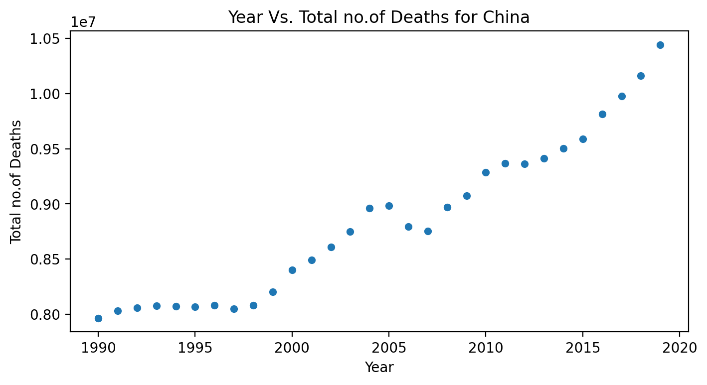
Visualisation:(cause of death in china)
#China"Total_no_of_Deaths" against "Year"
CODE:
China_Total_no_of_Deaths_df = df[df['Country/Territory']=='China'].sort_values(by='Total_no_of_Deaths',ascending=False)
#SCATTERPLOT"
# China - "Total_no_of_Deaths" against "Year"
CODE:
plt.figure(figsize=(5,2),dpi=200) sns.scatterplot(data=China_Total_no_of_Deaths_df, x='Year', y='Total_no_of_Deaths') plt.xlabel("Year") plt.ylabel("Total no.of Deaths") plt.title("Year Vs. Total no.of Deaths for China") plt.show();

Slide 12
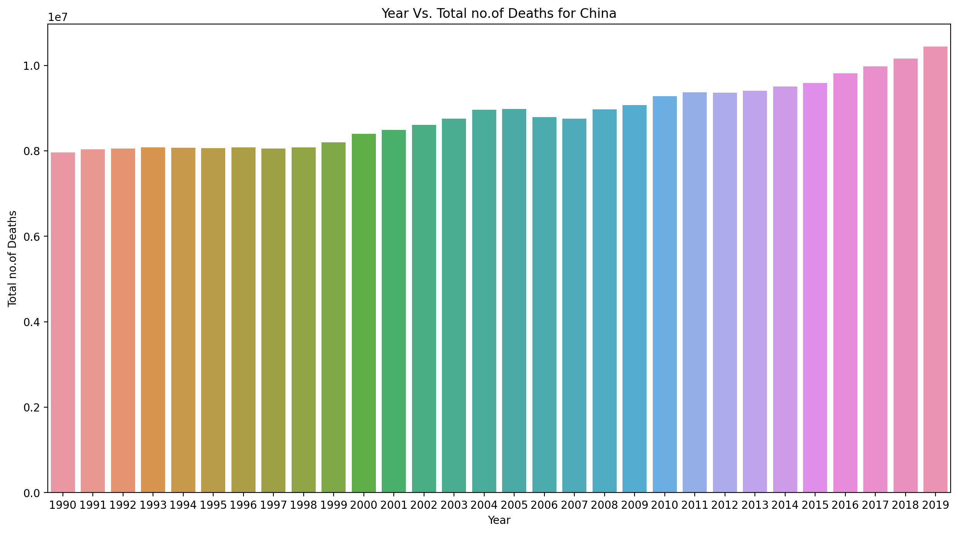
Year Vs Total no.of deaths:
#BARPLOT:
CODE:
plt.figure(figsize=(8,5),dpi=200) sns.barplot(data=China_Total_no_of_Deaths_df, x='Year', y='Total_no_of_Deaths') plt.xlabel("Year") plt.ylabel("Total no.of Deaths") plt.title("Year Vs. Total no.of Deaths for China") plt.show();

Slide 13
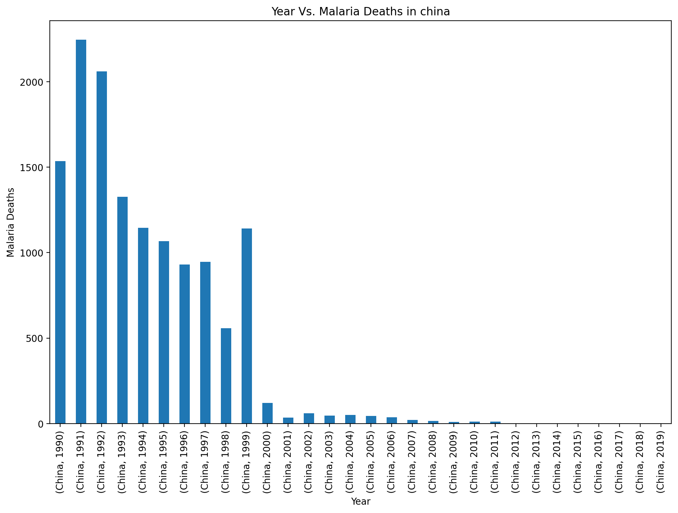
Year Vs malaria deahs in china:
CODE:
plt.figure(figsize=(12,8),dpi=200) china_df = China_Total_no_of_Deaths_df.groupby(['Country/Territory','Year']).sum() china_df['Malaria'].plot(kind='bar') plt.xlabel("Year") plt.ylabel("Malaria Deaths") plt.title("Year Vs. Malaria Deaths in china") plt.show();

Slide 14
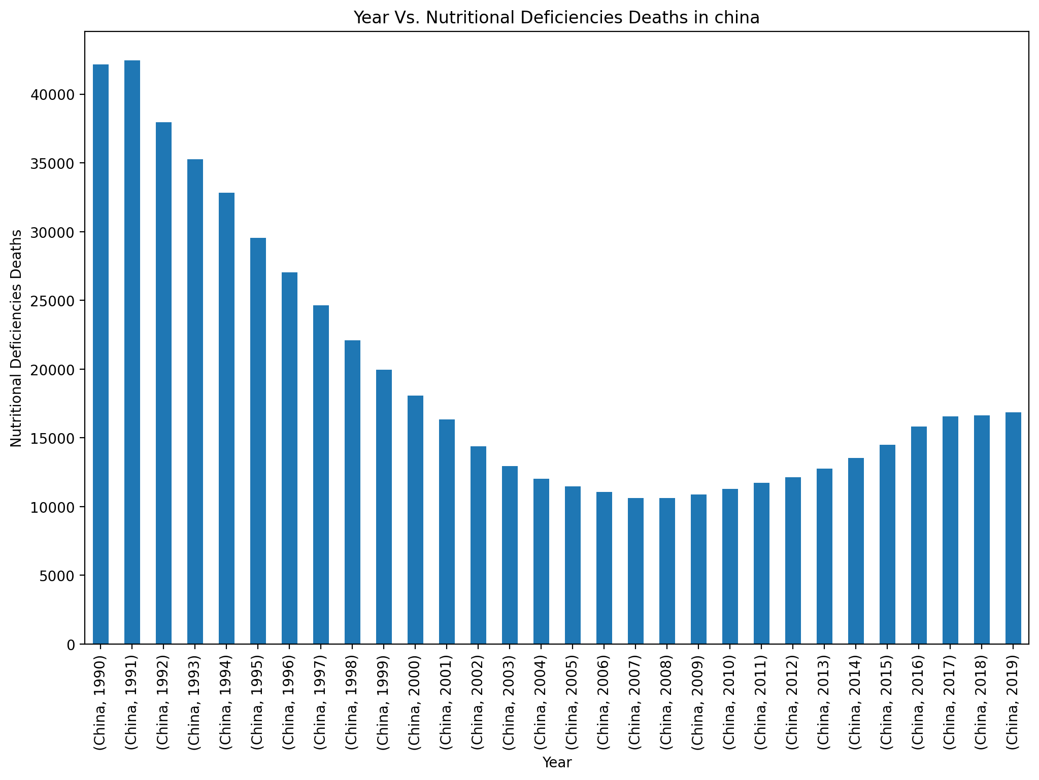
Year vs Nutritional Deficiences Deaths In china:
CODE:
plt.figure(figsize=(12,8),dpi=200) china_df = China_Total_no_of_Deaths_df.groupby(['Country/Territory','Year']).sum() china_df['Nutritional Deficiencies'].plot(kind='bar') plt.xlabel("Year") plt.ylabel("Nutritional Deficiencies Deaths") plt.title("Year Vs. Nutritional Deficiencies Deaths in china") plt.show();

Slide 15
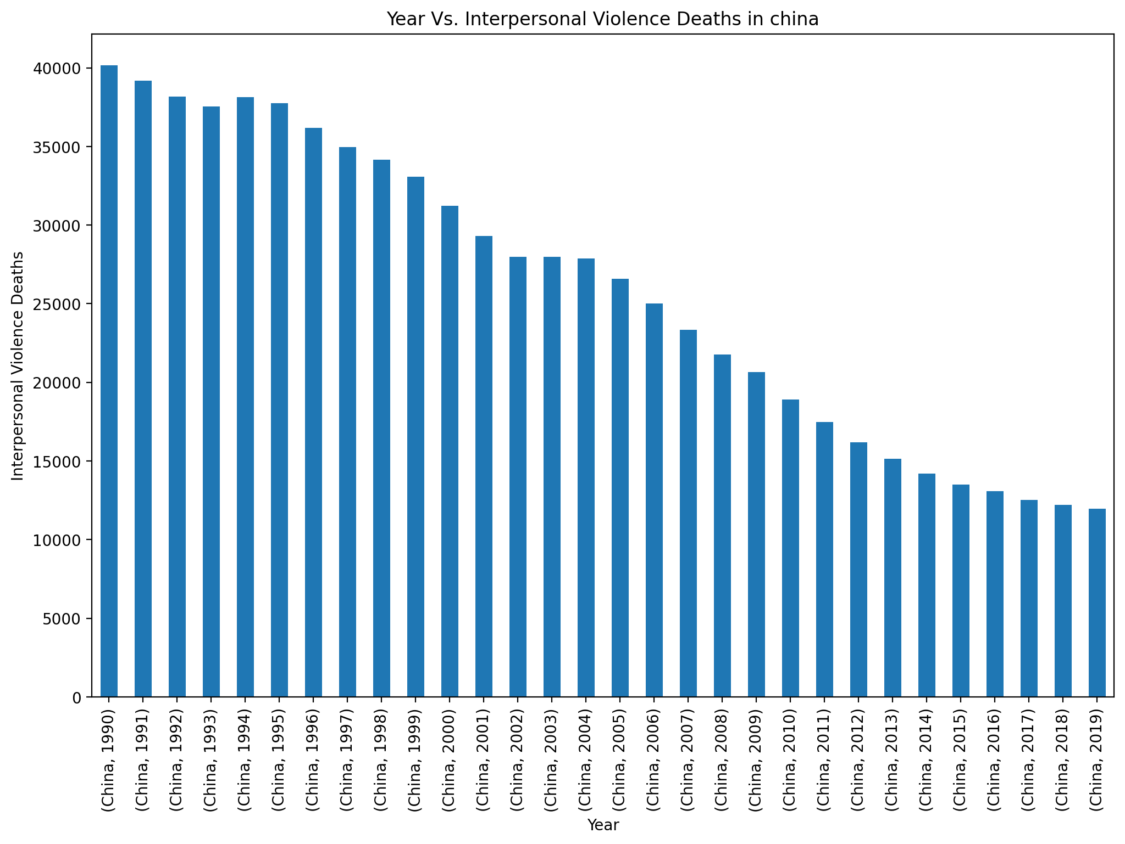
Year Vs Interpersonal Violence Deaths in china :
CODE :
plt.figure(figsize=(12,8),dpi=200) china_df = China_Total_no_of_Deaths_df.groupby(['Country/Territory','Year']).sum() china_df['Interpersonal Violence'].plot(kind='bar') plt.xlabel("Year") plt.ylabel("Interpersonal Violence Deaths") plt.title("Year Vs. Interpersonal Violence Deaths in china") plt.show();

Slide 16
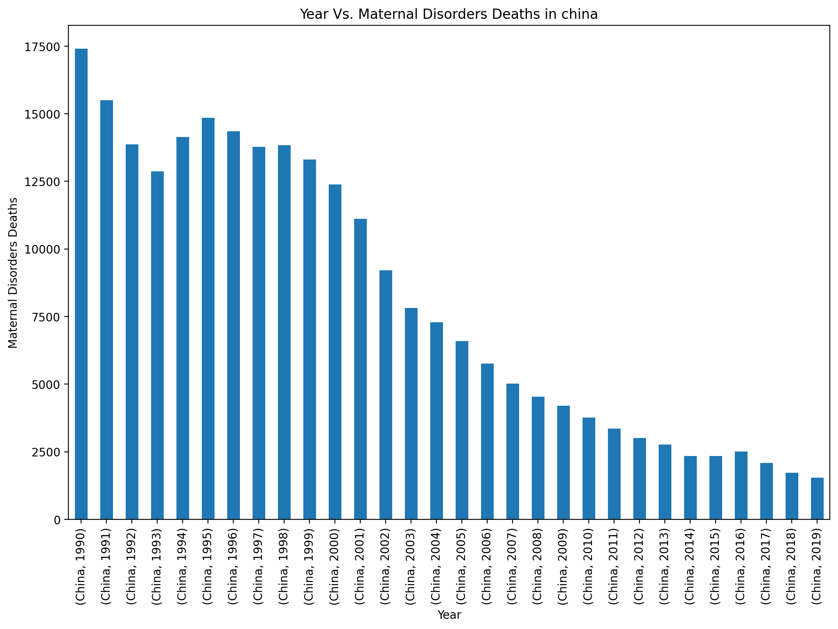
Year Vs Maternal Disorders Deaths in China:
CODE:
plt.figure(figsize=(12,8),dpi=200) china_df = China_Total_no_of_Deaths_df.groupby(['Country/Territory','Year']).sum() china_df['Maternal Disorders'].plot(kind='bar') plt.xlabel("Year") plt.ylabel("Maternal Disorders Deaths") plt.title("Year Vs. Maternal Disorders Deaths in china") plt.show();

Slide 17
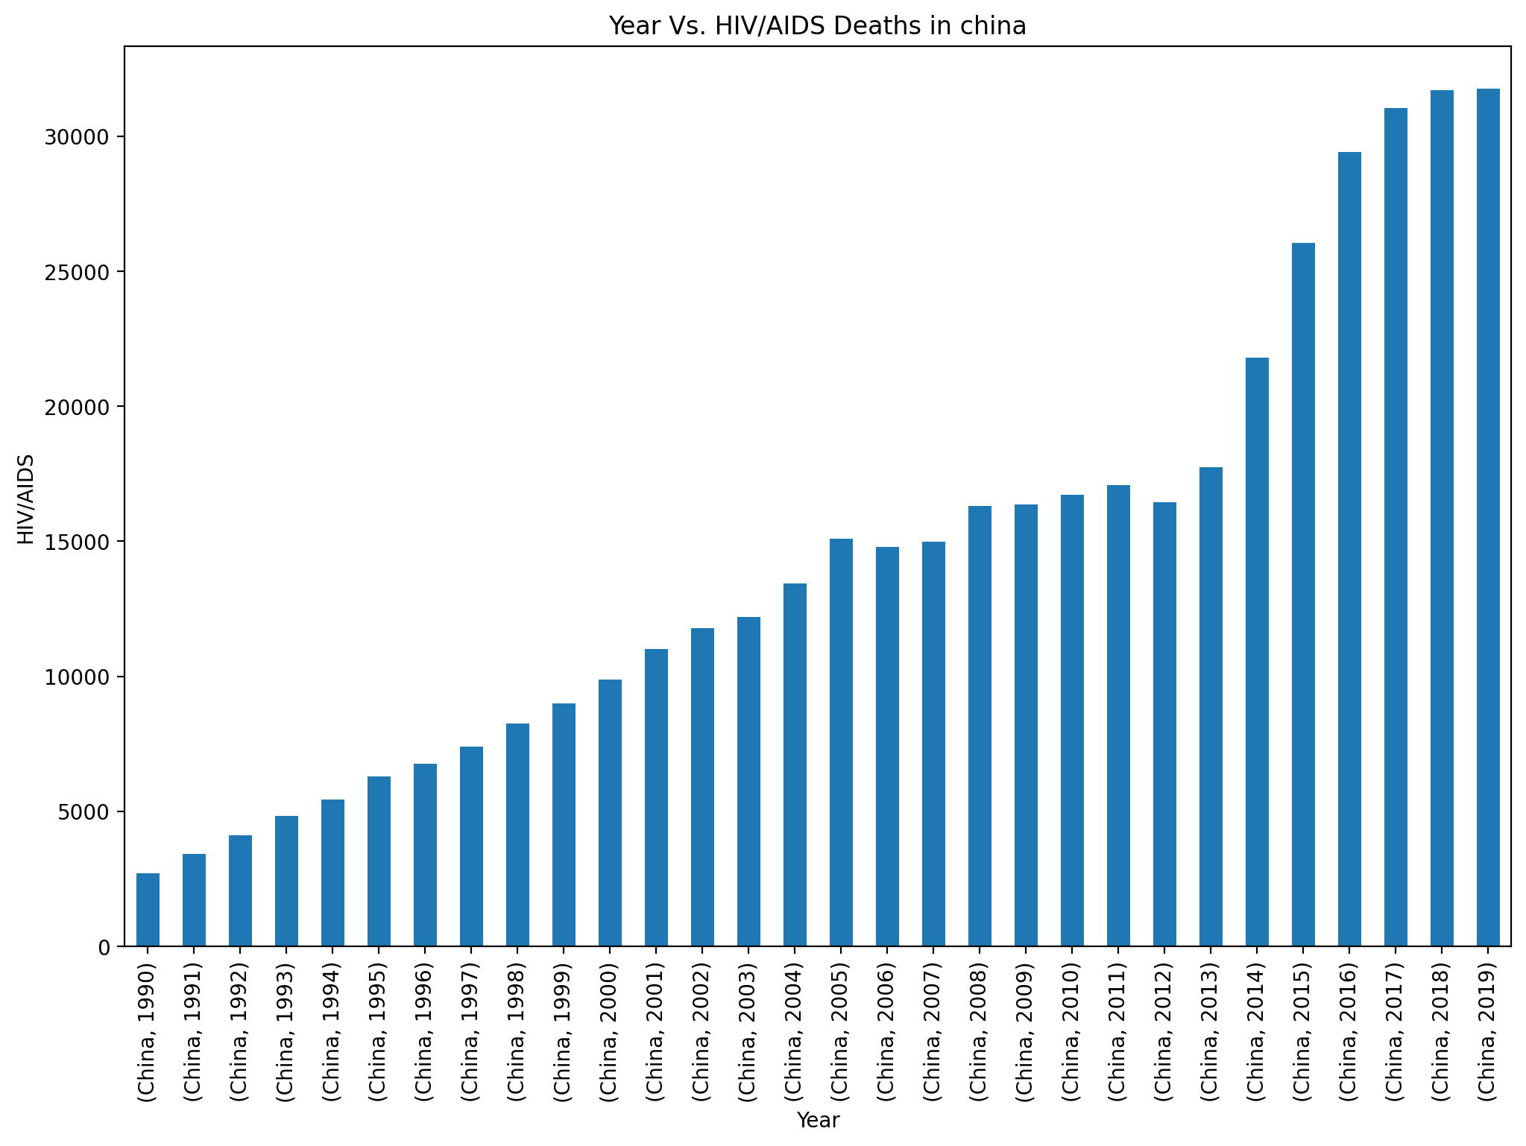
Year Vs HIV/AIDS Deaths in china:
CODE:
plt.figure(figsize=(12,8),dpi=200) china_df = China_Total_no_of_Deaths_df.groupby(['Country/Territory','Year']).sum() china_df['HIV/AIDS'].plot(kind='bar') plt.xlabel("Year") plt.ylabel("HIV/AIDS") plt.title("Year Vs. HIV/AIDS Deaths in china") plt.show();

Slide 18
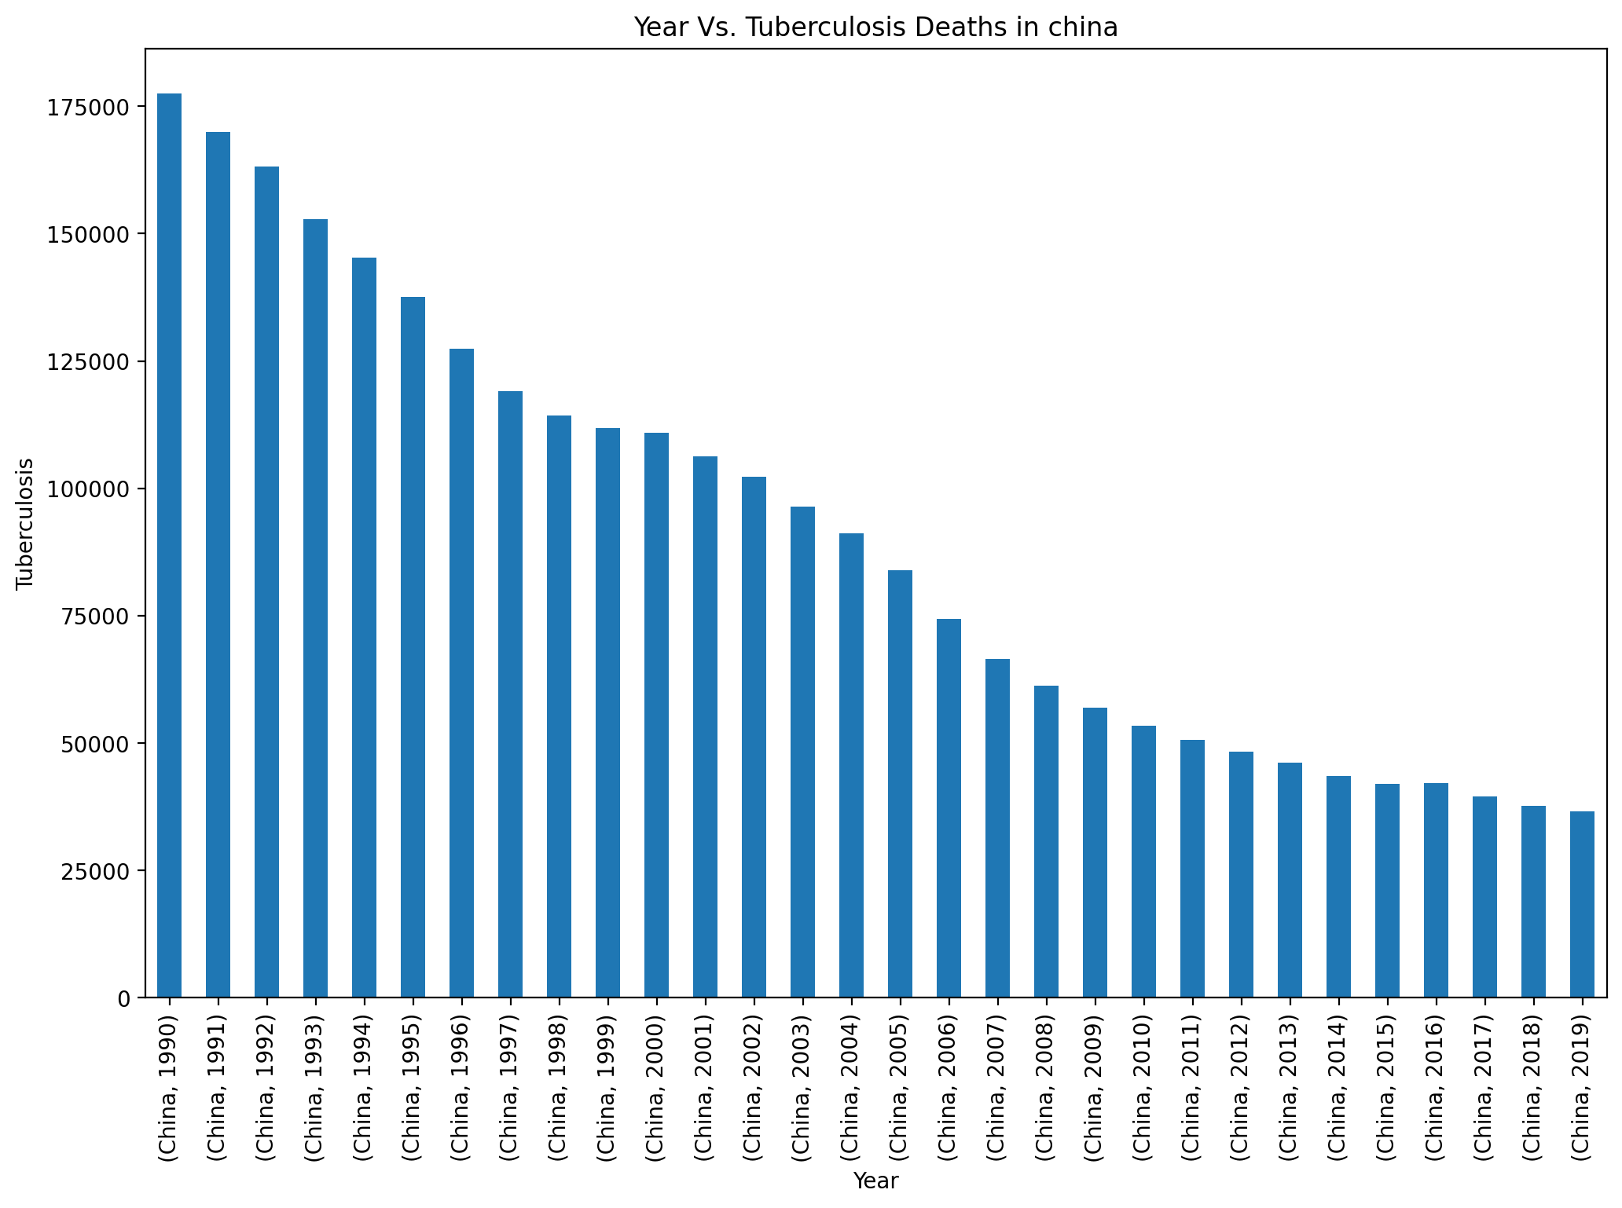
Year Vs Tuberculosis Deaths in china:
CODE:
plt.figure(figsize=(12,8),dpi=200) china_df = China_Total_no_of_Deaths_df.groupby(['Country/Territory','Year']).sum() china_df['Tuberculosis'].plot(kind='bar') plt.xlabel("Year") plt.ylabel("Tuberculosis") plt.title("Year Vs. Tuberculosis Deaths in china") plt.show();

Slide 19
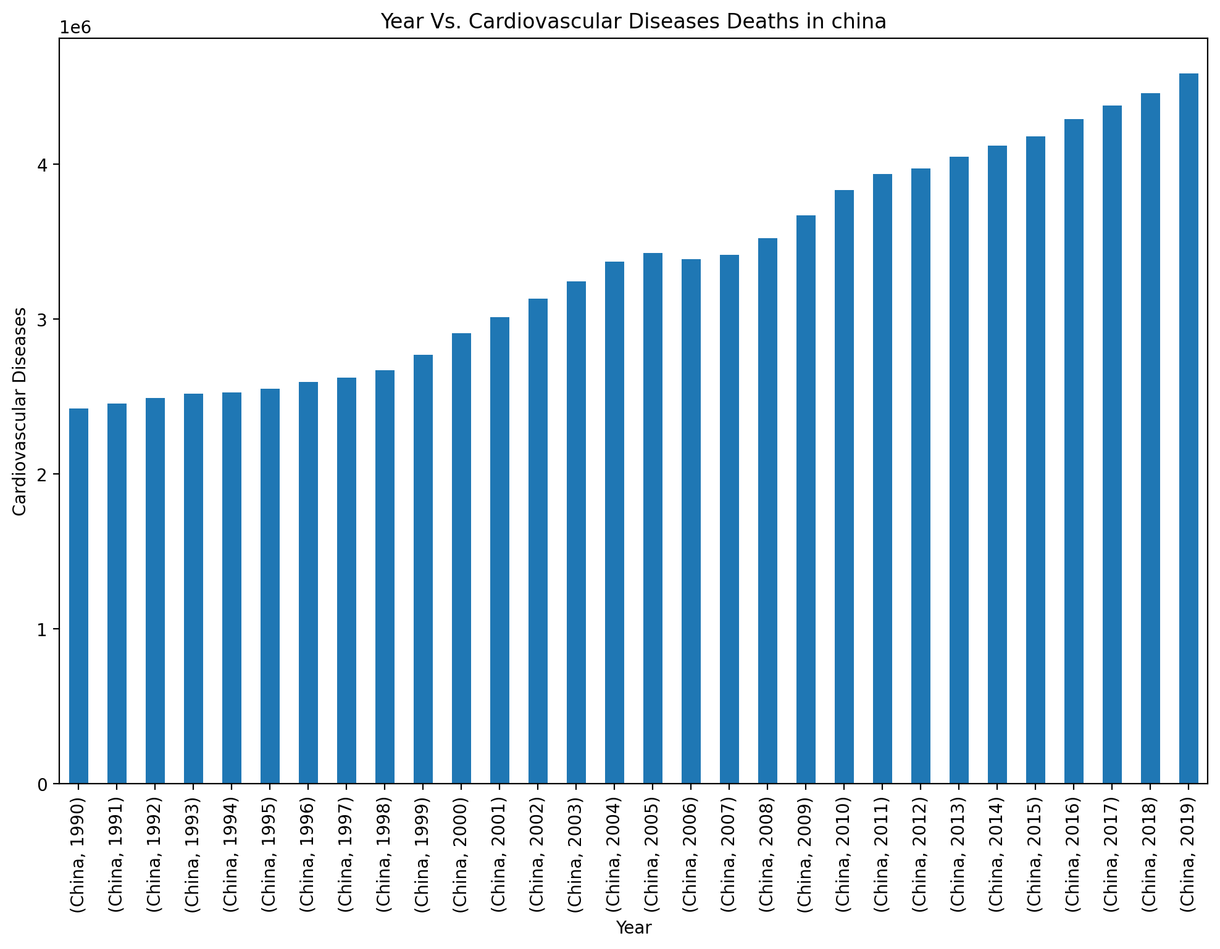
Year Vs Cardiovascular Diseases Deaths in China:
CODE:
plt.figure(figsize=(12,8),dpi=200) china_df = China_Total_no_of_Deaths_df.groupby(['Country/Territory','Year']).sum() china_df['Cardiovascular Diseases'].plot(kind='bar') plt.xlabel("Year") plt.ylabel("Cardiovascular Diseases") plt.title("Year Vs. Cardiovascular Diseases Deaths in china") plt.show();

Slide 20
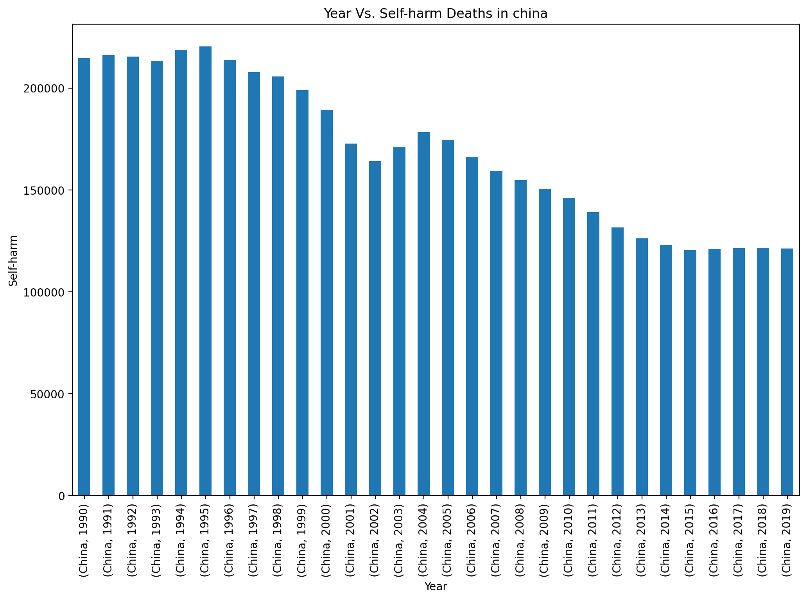
Year Vs Self-harm Deaths in china
CODE:
plt.figure(figsize=(12,8),dpi=200) china_df = China_Total_no_of_Deaths_df.groupby(['Country/Territory','Year']).sum() china_df['Self-harm'].plot(kind='bar') plt.xlabel("Year") plt.ylabel("Self-harm") plt.title("Year Vs. Self-harm Deaths in china") plt.show();

Slide 21
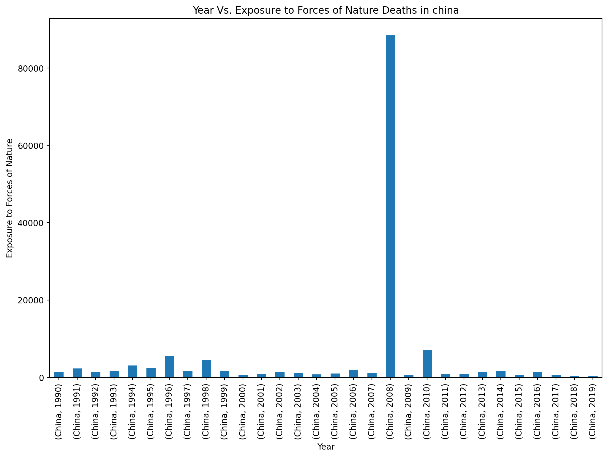
Year VS EXPOSURE TO FORCES OF NATURE DEATHS IN CHINA:
CODE:
plt.figure(figsize=(12,8),dpi=200) china_df = China_Total_no_of_Deaths_df.groupby(['Country/Territory','Year']).sum() china_df['Exposure to Forces of Nature'].plot(kind='bar') plt.xlabel("Year") plt.ylabel("Exposure to Forces of Nature") plt.title("Year Vs. Exposure to Forces of Nature Deaths in china") plt.show();

Slide 22
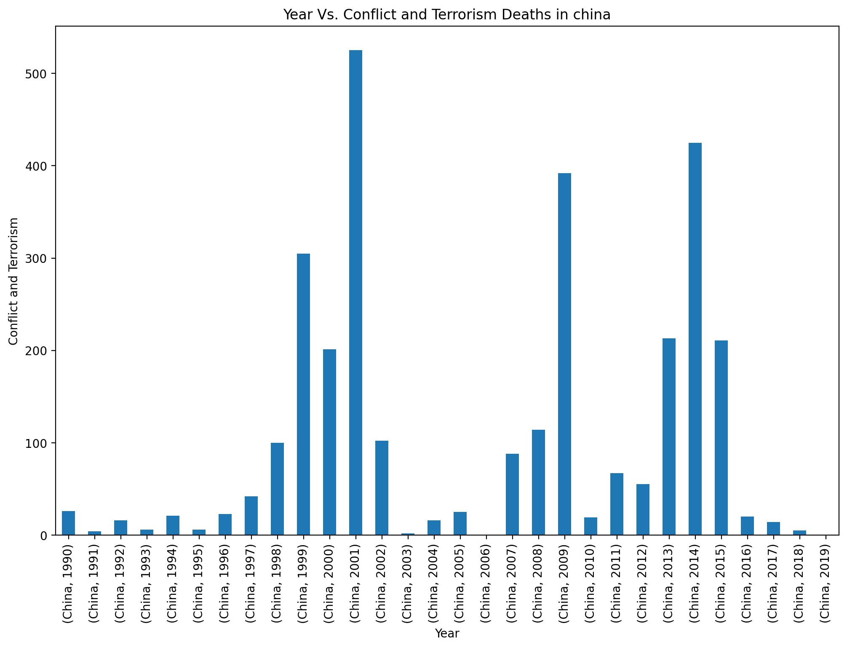
Years Vs Conflict and Terrorism Deaths in china:
CODE:
plt.figure(figsize=(12,8),dpi=200) china_df = China_Total_no_of_Deaths_df.groupby(['Country/Territory','Year']).sum() china_df['Conflict and Terrorism'].plot(kind='bar') plt.xlabel("Year") plt.ylabel("Conflict and Terrorism") plt.title("Year Vs. Conflict and Terrorism Deaths in china") plt.show();

Slide 23
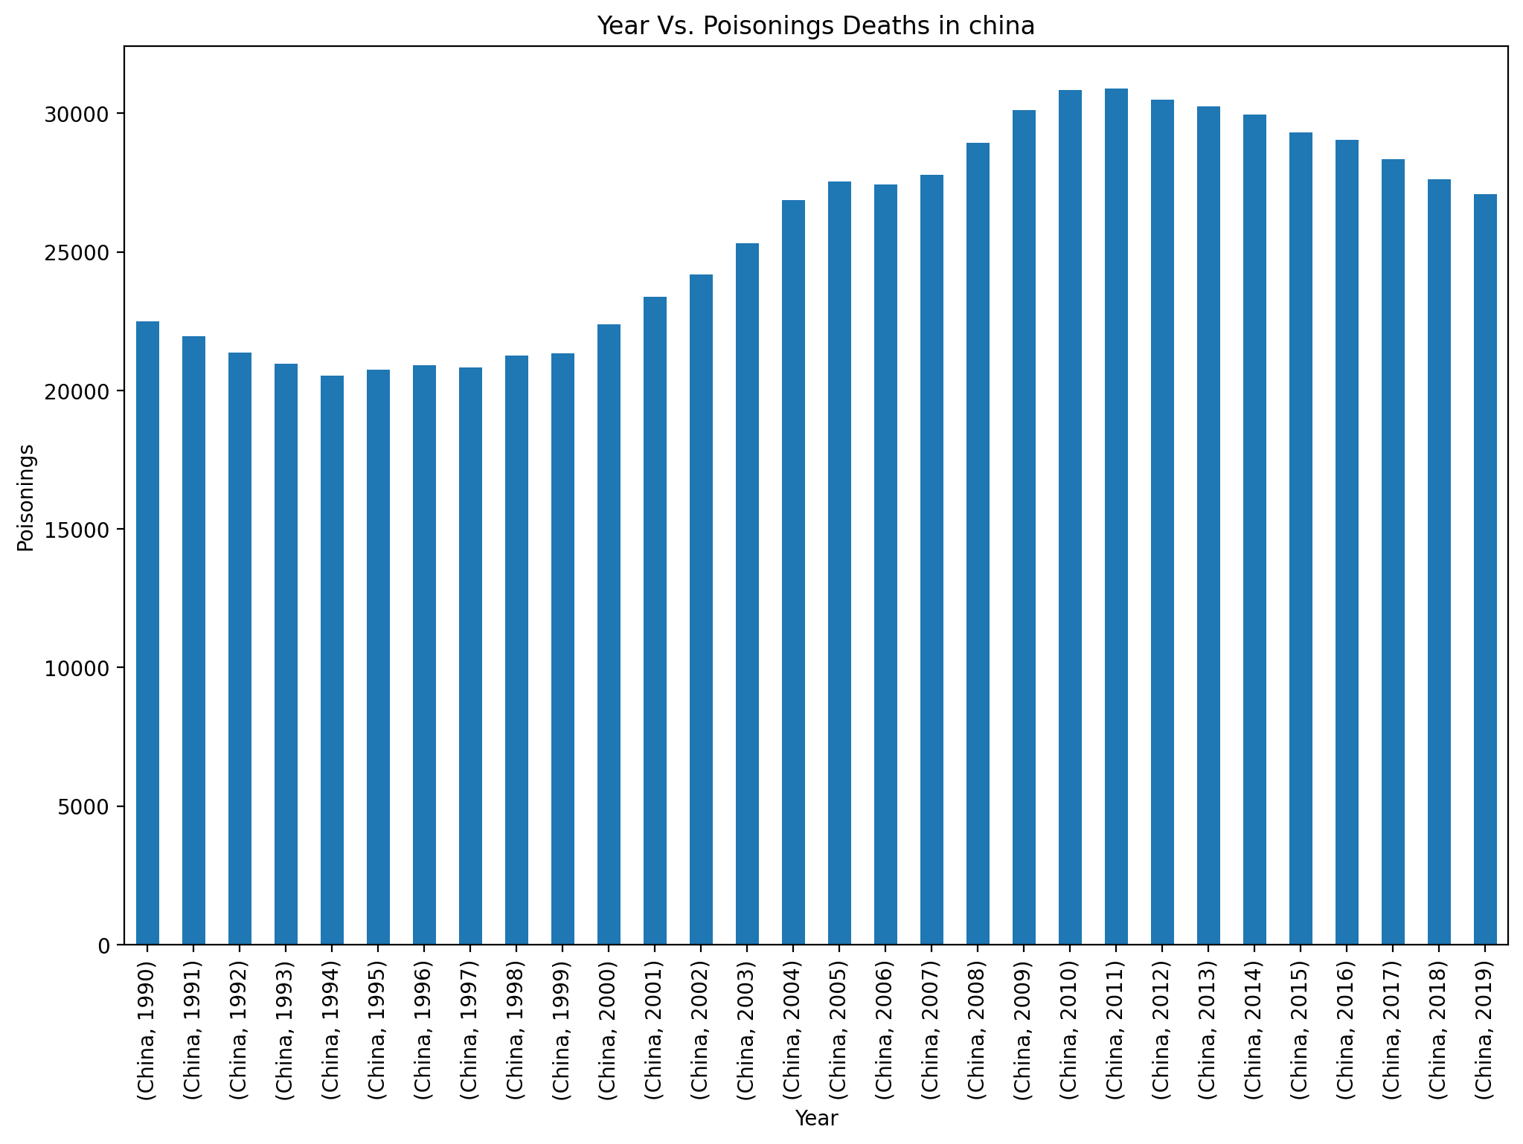
Years vs Poisinings Deaths In china:
CODE:
plt.figure(figsize=(12,8),dpi=200) china_df = China_Total_no_of_Deaths_df.groupby(['Country/Territory','Year']).sum() china_df['Poisonings'].plot(kind='bar') plt.xlabel("Year") plt.ylabel("Poisonings") plt.title("Year Vs. Poisonings Deaths in china") plt.show();

Slide 24
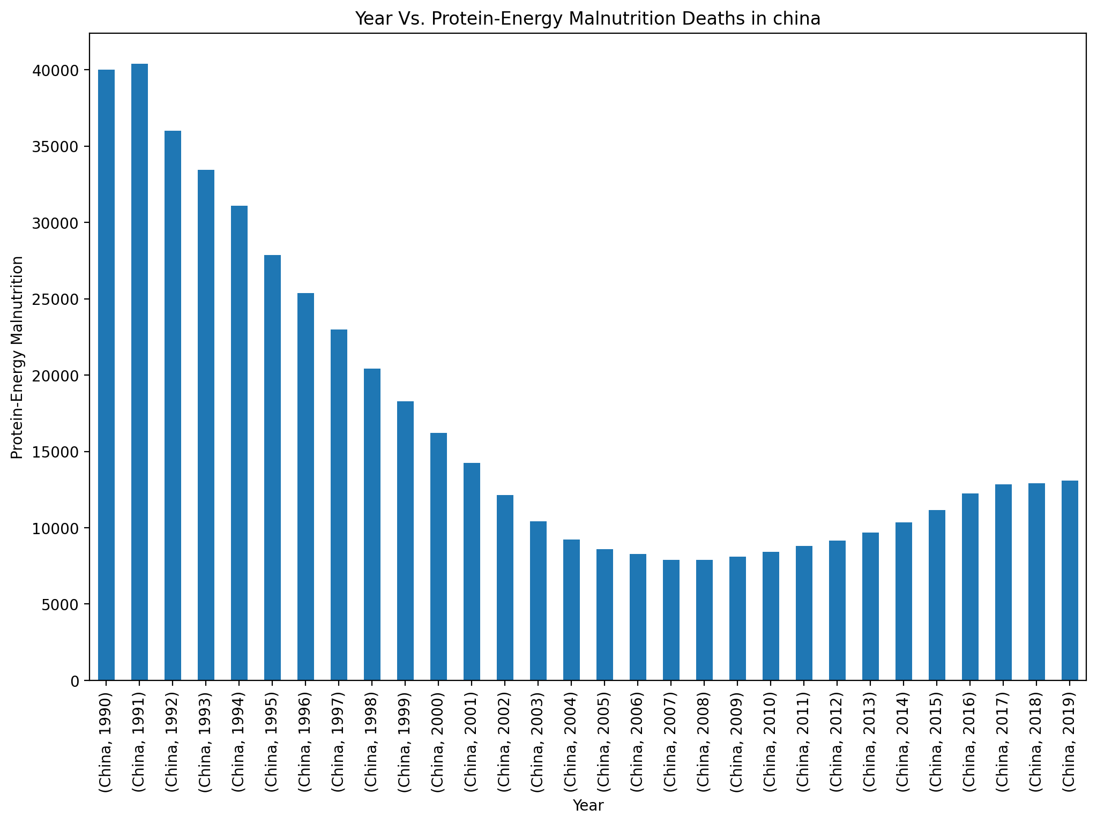
Year Vs Protein energy Malnutrition Deaths in china:
CODE:
plt.figure(figsize=(12,8),dpi=200) china_df = China_Total_no_of_Deaths_df.groupby(['Country/Territory','Year']).sum() china_df['Protein-Energy Malnutrition'].plot(kind='bar') plt.xlabel("Year") plt.ylabel("Protein-Energy Malnutrition") plt.title("Year Vs. Protein-Energy Malnutrition Deaths in china") plt.show();

Slide 25
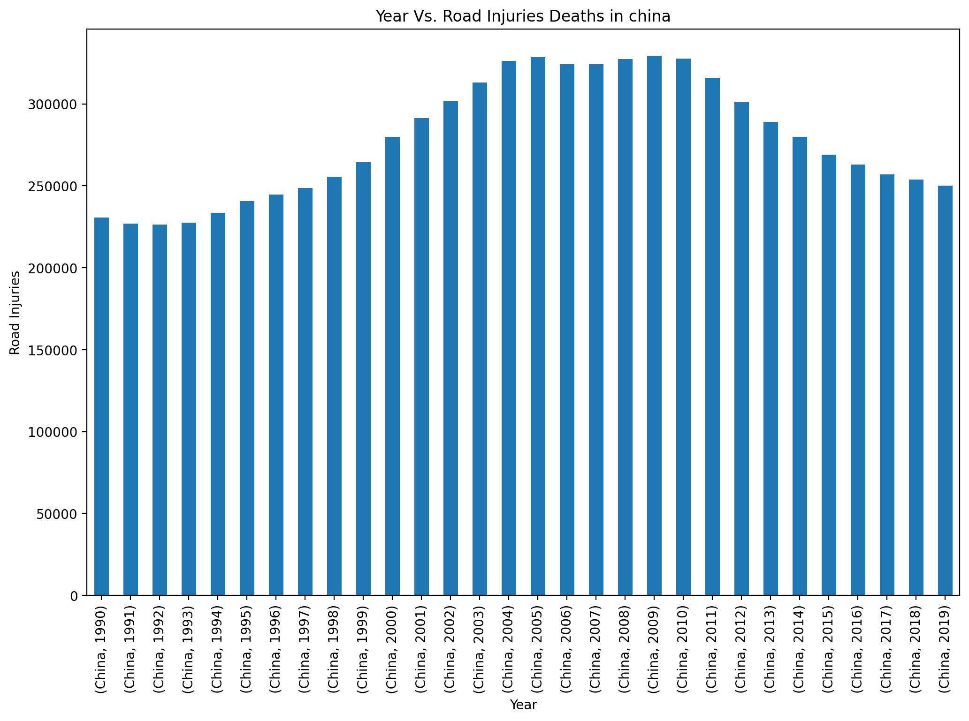
Year Vs Road Injuries Deaths in China:
CODE:
plt.figure(figsize=(12,8),dpi=200) china_df = China_Total_no_of_Deaths_df.groupby(['Country/Territory','Year']).sum() china_df['Road Injuries'].plot(kind='bar') plt.xlabel("Year") plt.ylabel("Road Injuries") plt.title("Year Vs. Road Injuries Deaths in china") plt.show();

Slide 26
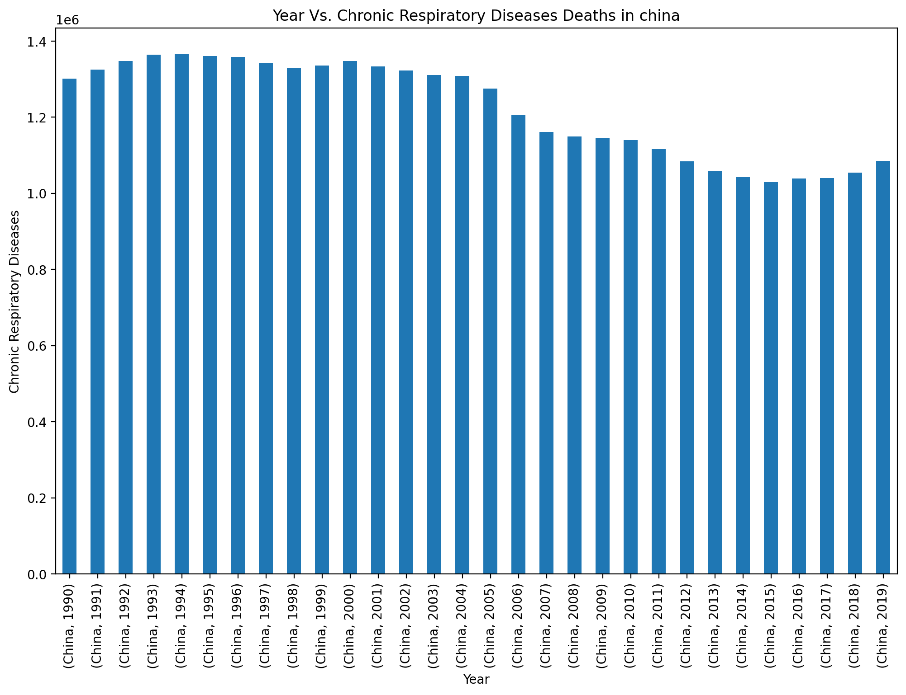
Year Vs Chronic Respiratory Deaths in china:
CODE:
plt.figure(figsize=(12,8),dpi=200) china_df = China_Total_no_of_Deaths_df.groupby(['Country/Territory','Year']).sum() china_df['Chronic Respiratory Diseases'].plot(kind='bar') plt.xlabel("Year") plt.ylabel("Chronic Respiratory Diseases") plt.title("Year Vs. Chronic Respiratory Diseases Deaths in china") plt.show();

Slide 27
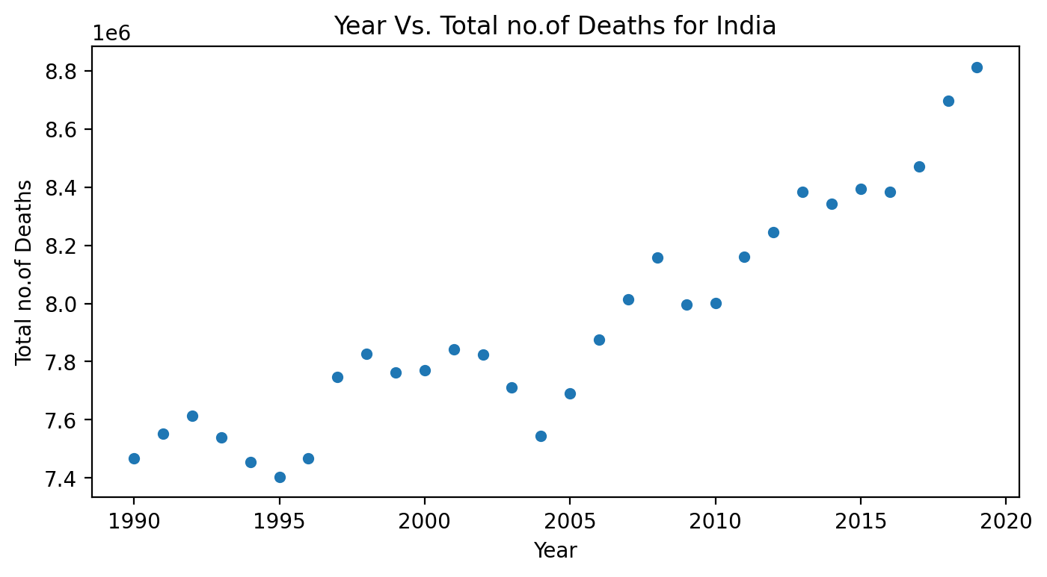
India Data Visualization :
Year Vs Total no. of Deaths for India :
India Data Visualization :
# India - "Total_no_of_Deaths" against "Year"
CODE:
->
India_Total_no_of_Deaths_df =
df[df['Country/Territory']=='India'].sort
_values(by='Total_no_of_Deaths',as cending=False)
# India - "Total_no_of_Deaths" against "Year“
CODE:
plt.figure(figsize=(8,4),dpi=200)
sns.scatterplot(data=India_Total_no
_of_Deaths_df,
x='Year', y='Total_no_of_Deaths')
plt.xlabel("Year") plt.ylabel("Total
no.of Deaths") plt.title("Year Vs. Total
no.of Deaths for India") plt.show();

Slide 28
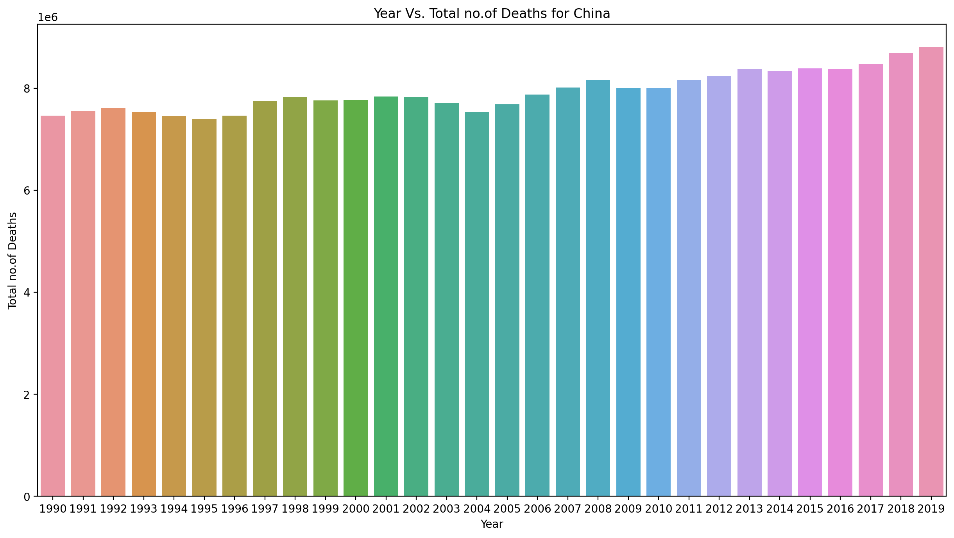
Year Vs Total no. of Death For China:
CODE:
plt.figure(figsize=(15,10),dpi=200) sns.barplot(data=India_Total_no_of_Deaths_df, x='Year', y='Total_no_of_Deaths') plt.xlabel("Year") plt.ylabel("Total no.of Deaths") plt.title("Year Vs. Total no.of Deaths for China") plt.show();

Slide 29
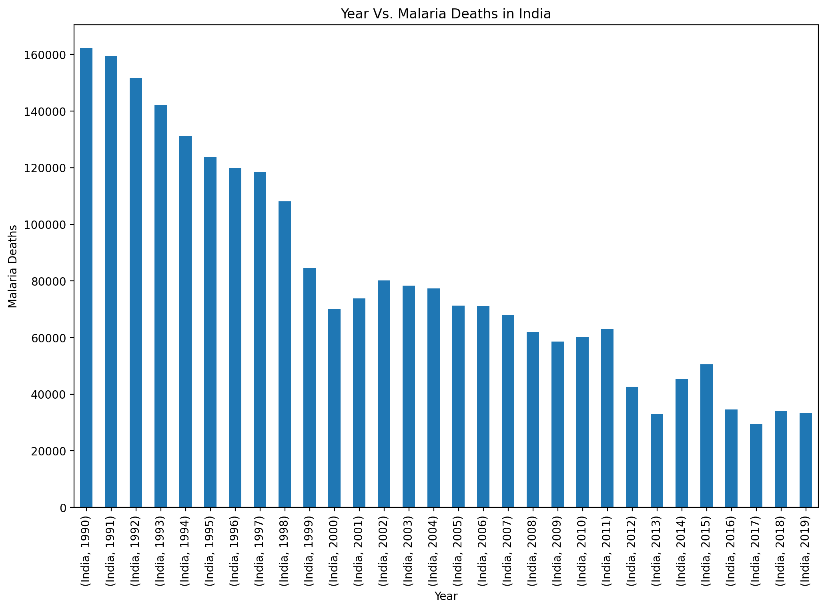
Year vs malaria deaths in india:
Common Causes of Death:
CODE:
plt.figure(figsize=(12,8),dpi=200) china_df = India_Total_no_of_Deaths_df.groupby(['Country/Territory','Year']).sum() china_df['Malaria'].plot(kind='bar') plt.xlabel("Year") plt.ylabel("Malaria Deaths") plt.title("Year Vs. Malaria Deaths in India") plt.show();

Slide 30
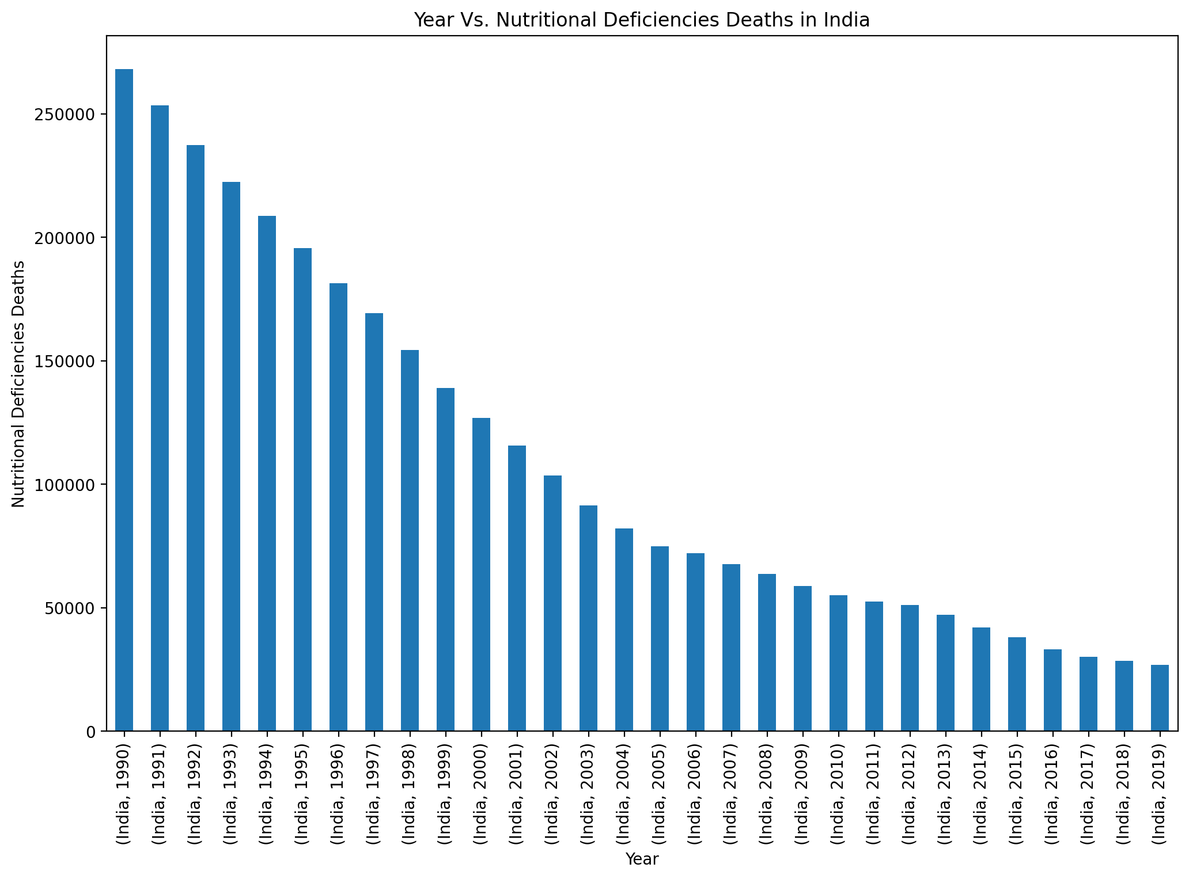
Year vs nutritional deficiences deaths in india:
CODE:
plt.figure(figsize=(12,8),dpi=200) china_df = India_Total_no_of_Deaths_df.groupby(['Country/Territory','Year']).sum() china_df['Nutritional Deficiencies'].plot(kind='bar') plt.xlabel("Year") plt.ylabel("Nutritional Deficiencies Deaths") plt.title("Year Vs. Nutritional Deficiencies Deaths in India") plt.show();

Slide 31
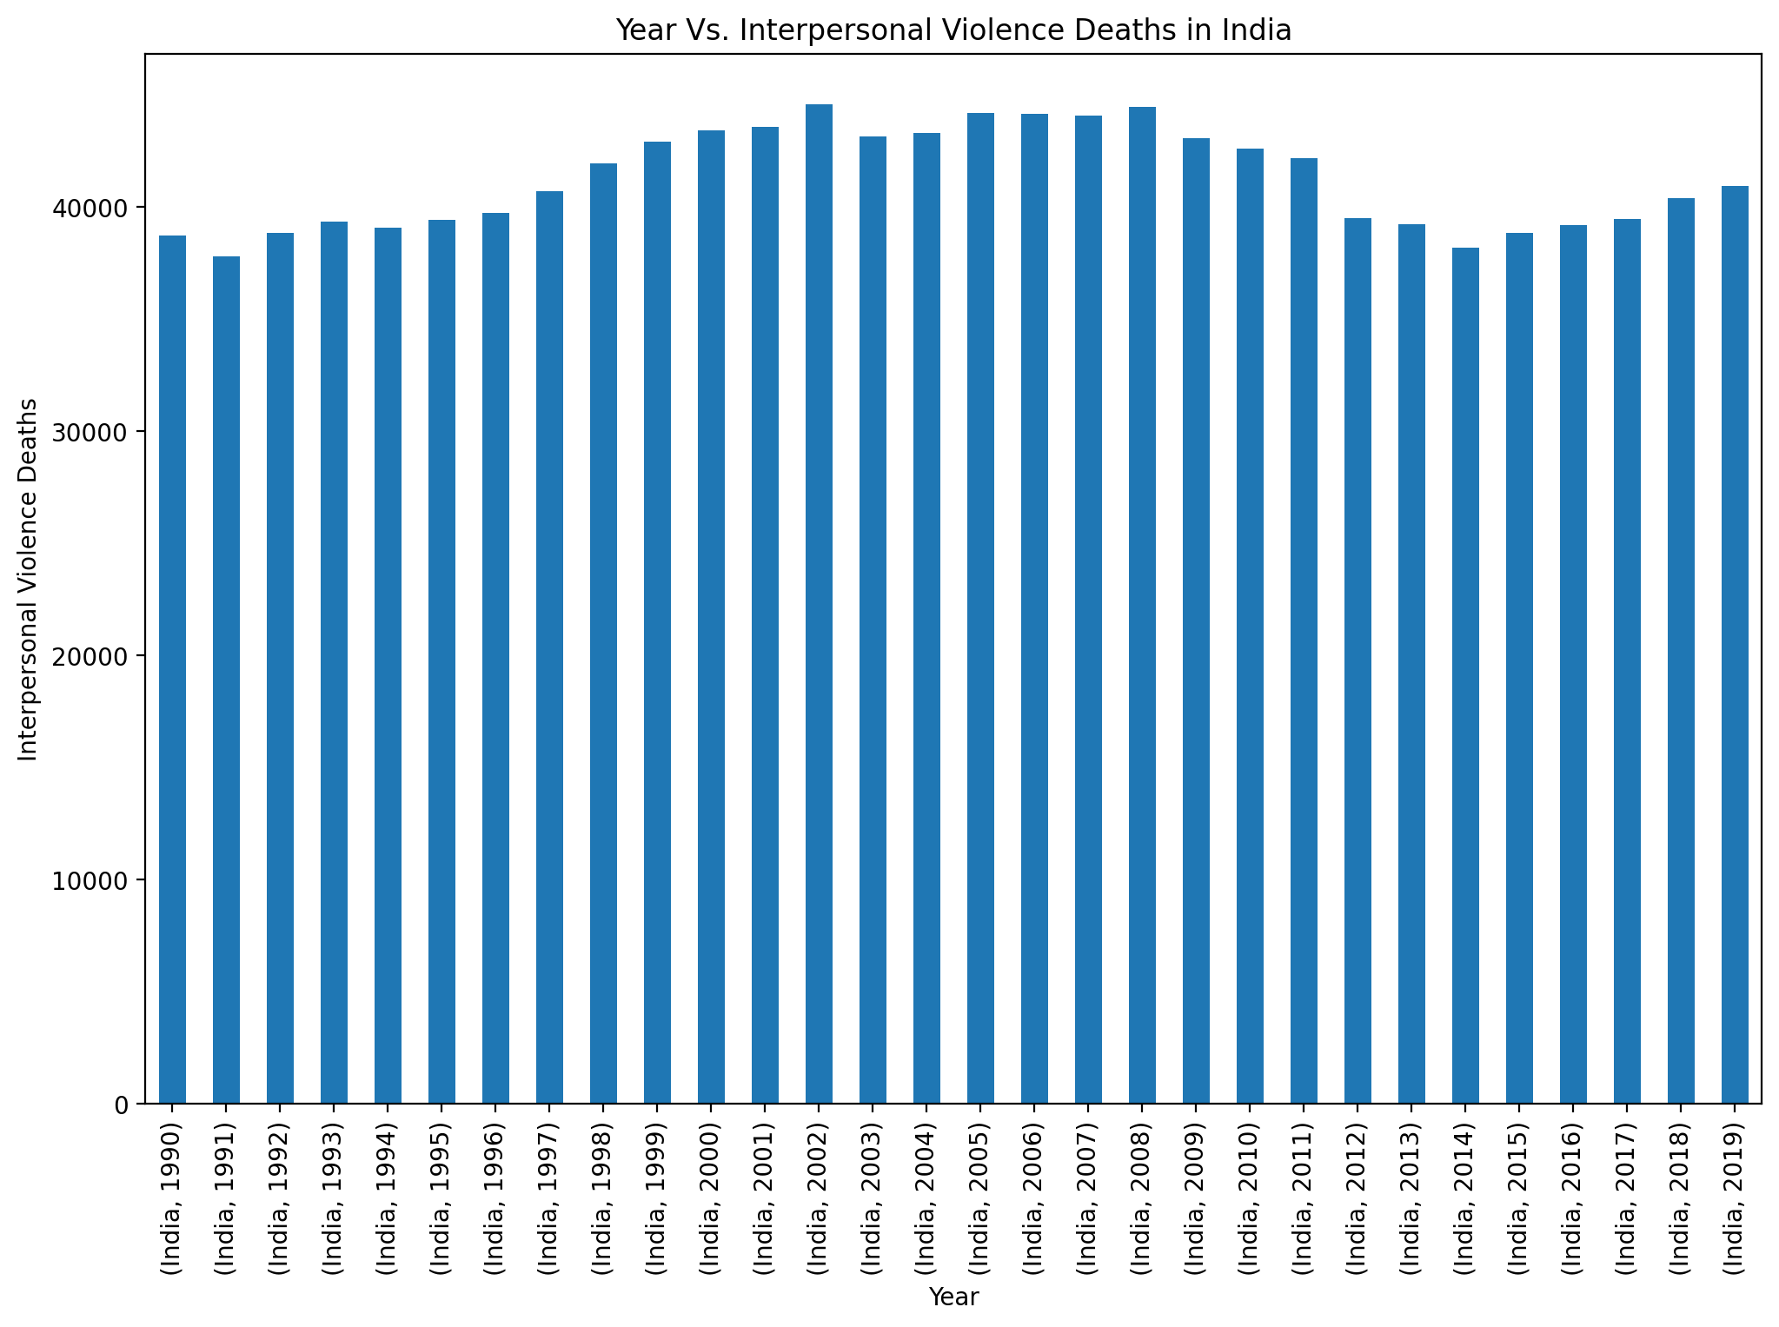
YEAR VS INTERPERSONAL VIOLENCE DEATHS IN INDIA:
CODE:
plt.figure(figsize=(12,8),dpi=200) china_df = India_Total_no_of_Deaths_df.groupby(['Country/Territory','Year']).sum() china_df['Interpersonal Violence'].plot(kind='bar') plt.xlabel("Year") plt.ylabel("Interpersonal Violence Deaths") plt.title("Year Vs. Interpersonal Violence Deaths in India") plt.show();

Slide 32
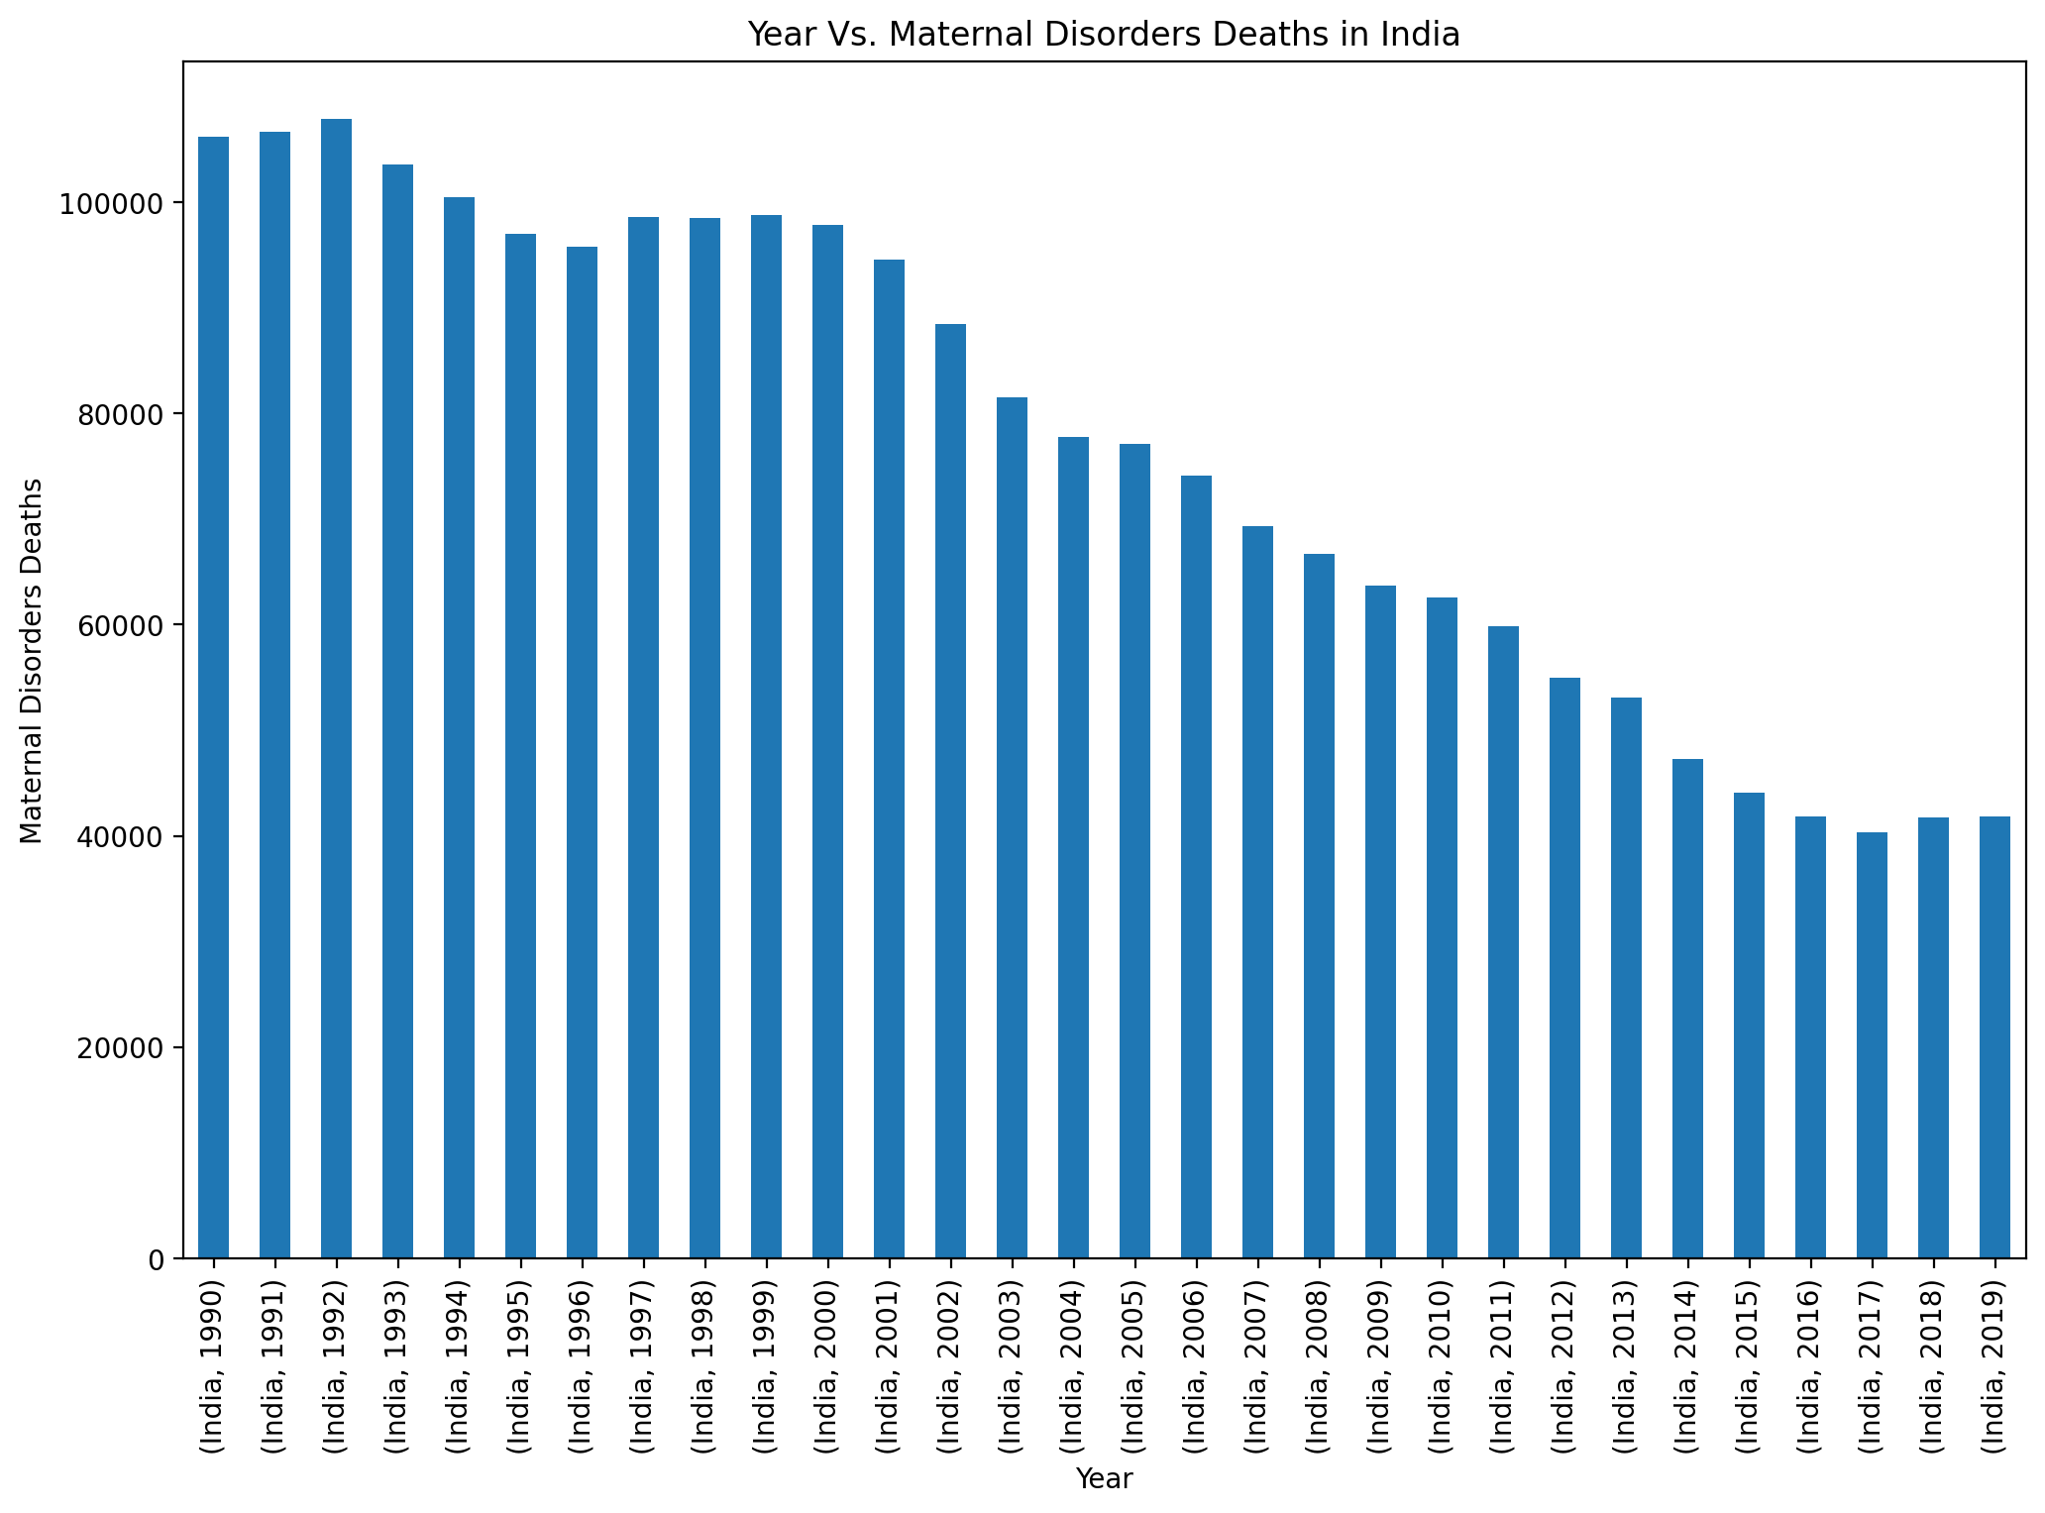
YEAR VS MATERNAL DISORDERS DEATHS IN INDIA:
CODE:
plt.figure(figsize=(12,8),dpi=200) china_df = India_Total_no_of_Deaths_df.groupby(['Country/Territory','Year']).sum() china_df['Maternal Disorders'].plot(kind='bar') plt.xlabel("Year") plt.ylabel("Maternal Disorders Deaths") plt.title("Year Vs. Maternal Disorders Deaths in India") plt.show();

Slide 33
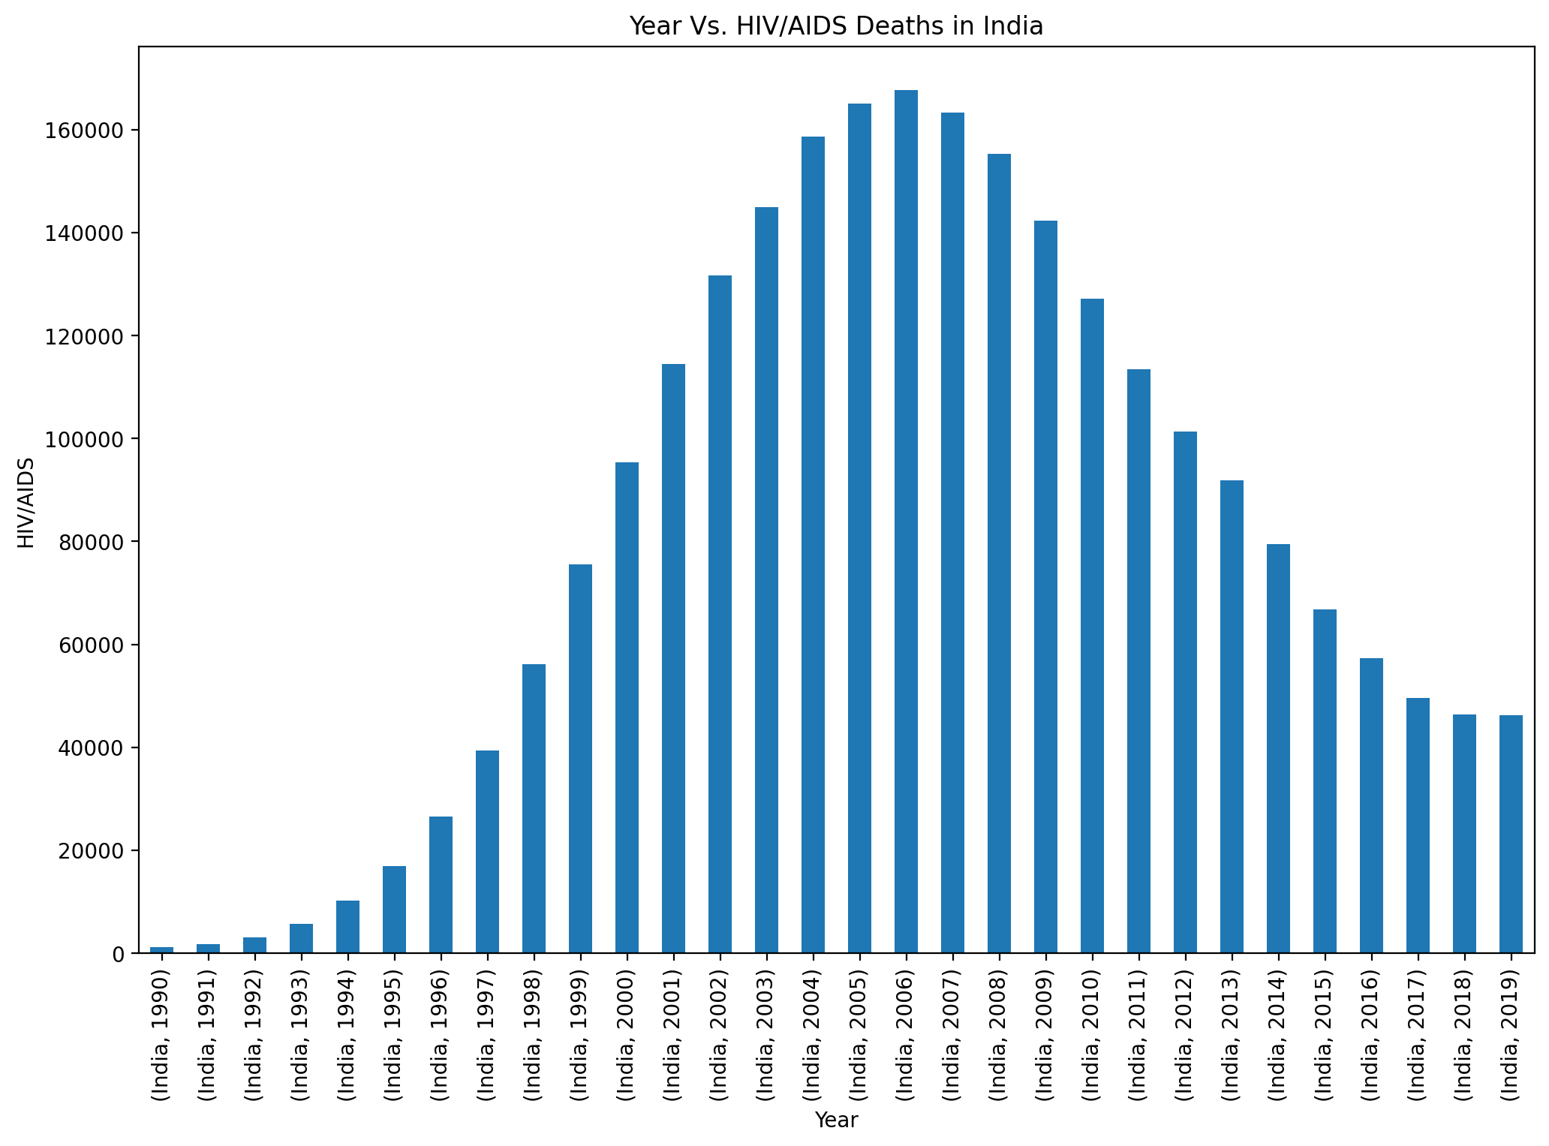
Year vs hiv/aids deaths in india:
CODE:
plt.figure(figsize=(12,8),dpi=200) china_df = India_Total_no_of_Deaths_df.groupby(['Country/Territory','Year']).sum() china_df['HIV/AIDS'].plot(kind='bar') plt.xlabel("Year") plt.ylabel("HIV/AIDS") plt.title("Year Vs. HIV/AIDS Deaths in India") plt.show();

Slide 34
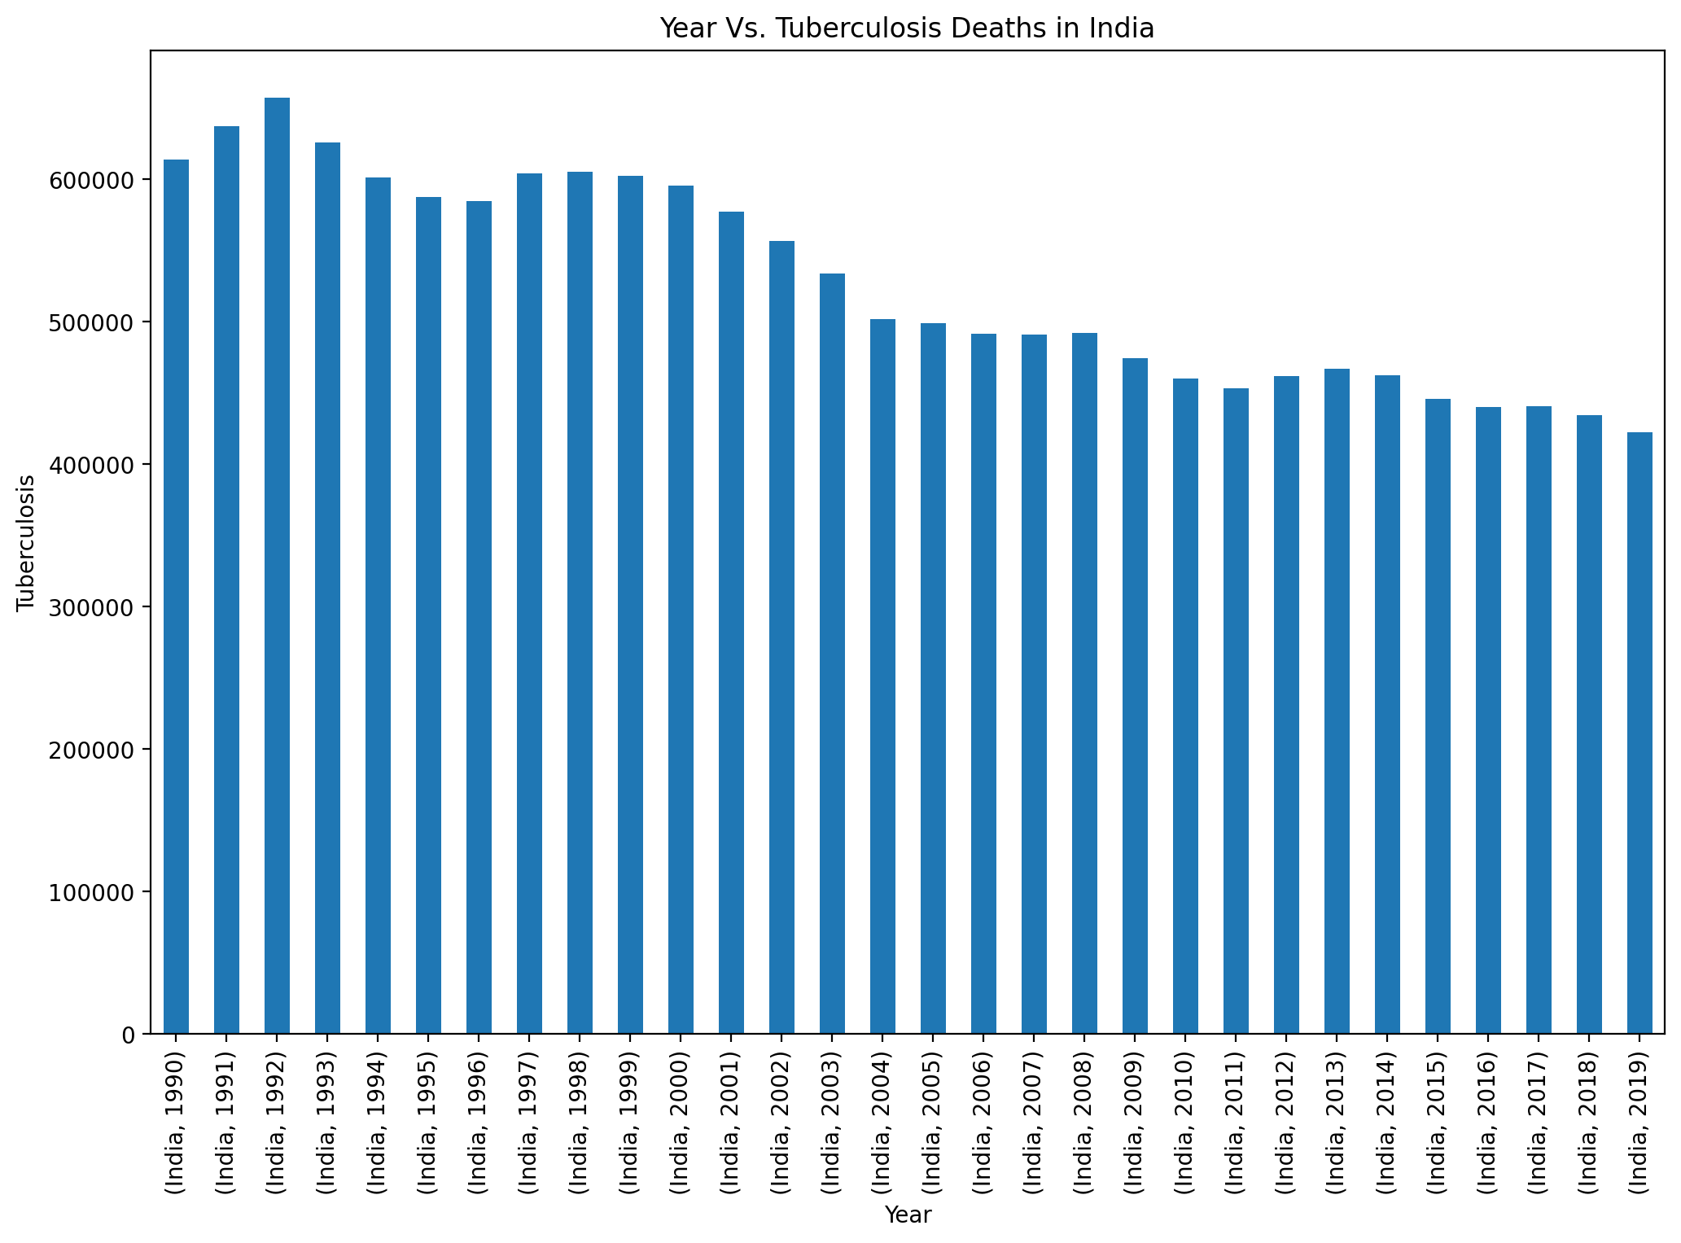
Year vs tuberculosis deaths in india:
CODE:
plt.figure(figsize=(12,8),dpi=200) china_df = India_Total_no_of_Deaths_df.groupby(['Country/Territory','Year']).sum() china_df['Tuberculosis'].plot(kind='bar') plt.xlabel("Year") plt.ylabel("Tuberculosis") plt.title("Year Vs. Tuberculosis Deaths in India") plt.show();

Slide 35
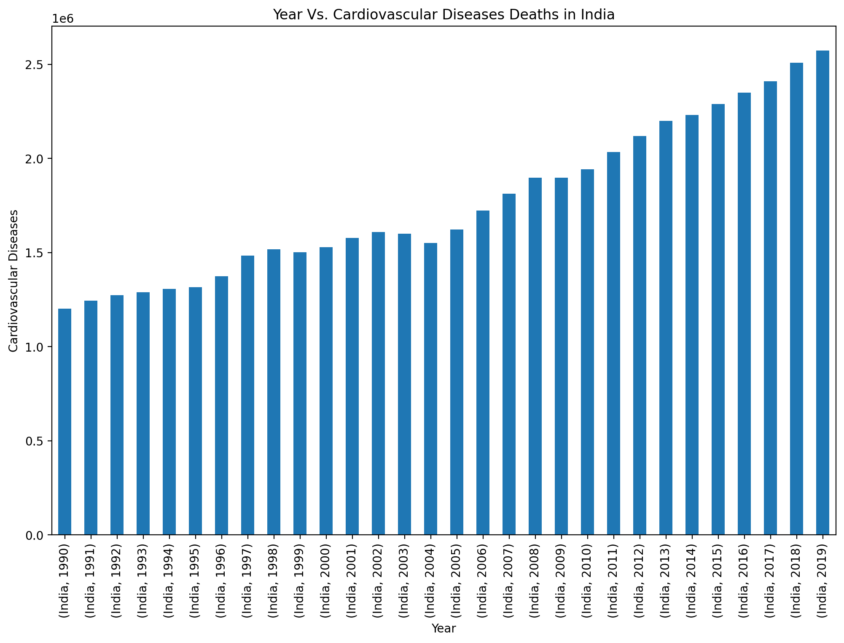
YEAR VS CARDIOVASCULAR DEATHS IN INDIA:
CODE:
plt.figure(figsize=(12,8),dpi=200) china_df = India_Total_no_of_Deaths_df.groupby(['Country/Territory','Year']).sum() china_df['Cardiovascular Diseases'].plot(kind='bar') plt.xlabel("Year") plt.ylabel("Cardiovascular Diseases") plt.title("Year Vs. Cardiovascular Diseases Deaths in India") plt.show();

Slide 36
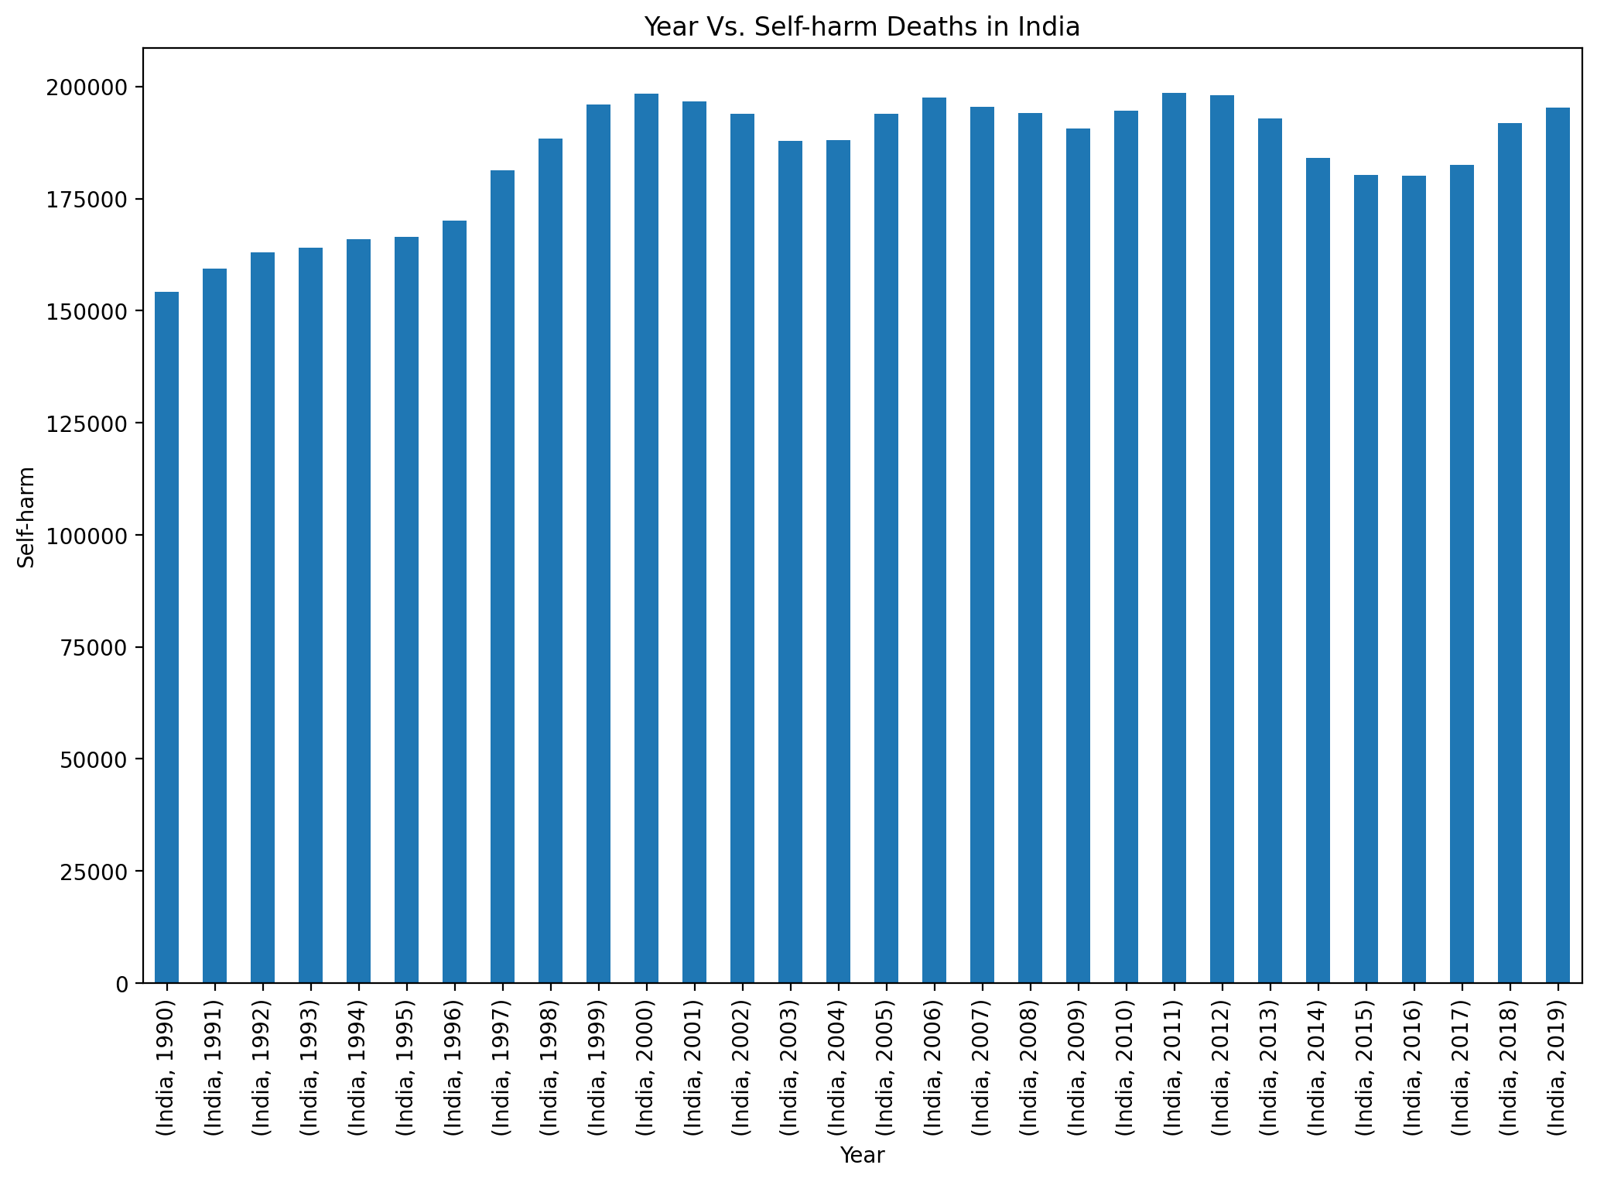
YEAR VS SELF-HARM DEATHS IN INDIA:
CODE:
plt.figure(figsize=(12,8),dpi=200) china_df = India_Total_no_of_Deaths_df.groupby(['Country/Territory','Year']).sum() china_df['Self-harm'].plot(kind='bar') plt.xlabel("Year") plt.ylabel("Self-harm") plt.title("Year Vs. Self-harm Deaths in India") plt.show();

Slide 37
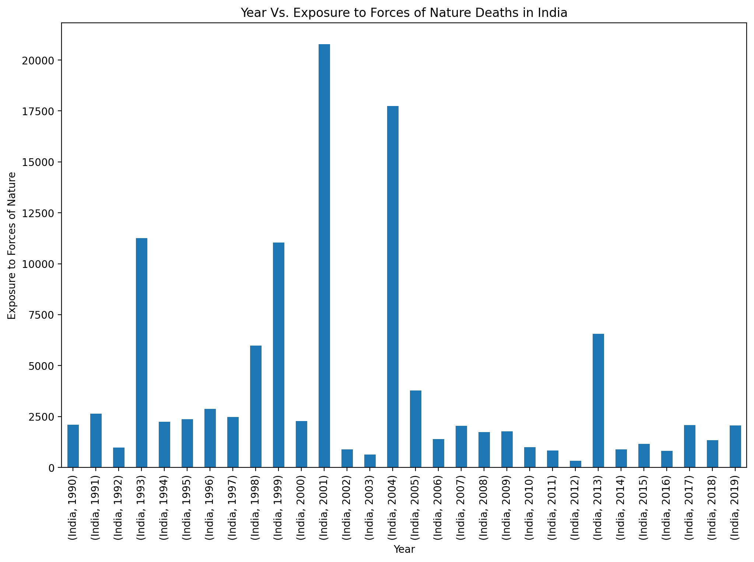
Year vs exposure to nature deaths in india:
CODE:
plt.figure(figsize=(12,8),dpi=200) china_df = India_Total_no_of_Deaths_df.groupby(['Country/Territory','Year']).sum() china_df['Exposure to Forces of Nature'].plot(kind='bar') plt.xlabel("Year") plt.ylabel("Exposure to Forces of Nature") plt.title("Year Vs. Exposure to Forces of Nature Deaths in India") plt.show();

Slide 38
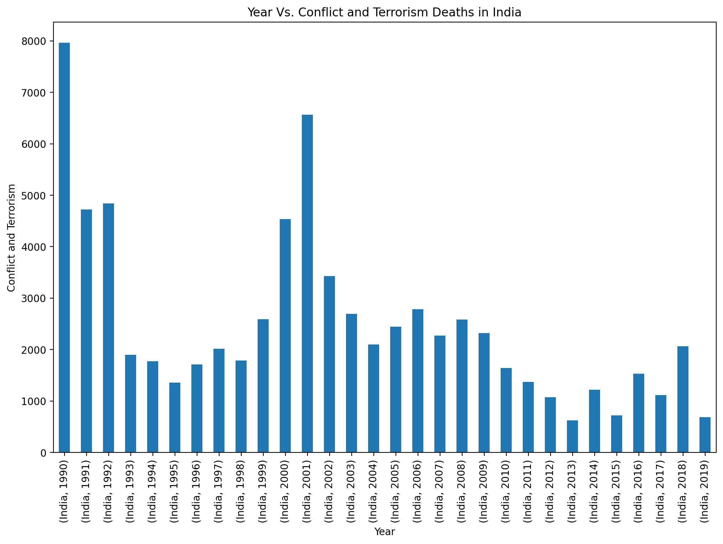
Year vs conflict and terrorism deaths in india :
CODE:
plt.figure(figsize=(12,8),dpi=200) china_df = India_Total_no_of_Deaths_df.groupby(['Country/Territory','Year']).sum() china_df['Conflict and Terrorism'].plot(kind='bar') plt.xlabel("Year") plt.ylabel("Conflict and Terrorism") plt.title("Year Vs. Conflict and Terrorism Deaths in India") plt.show();

Slide 39
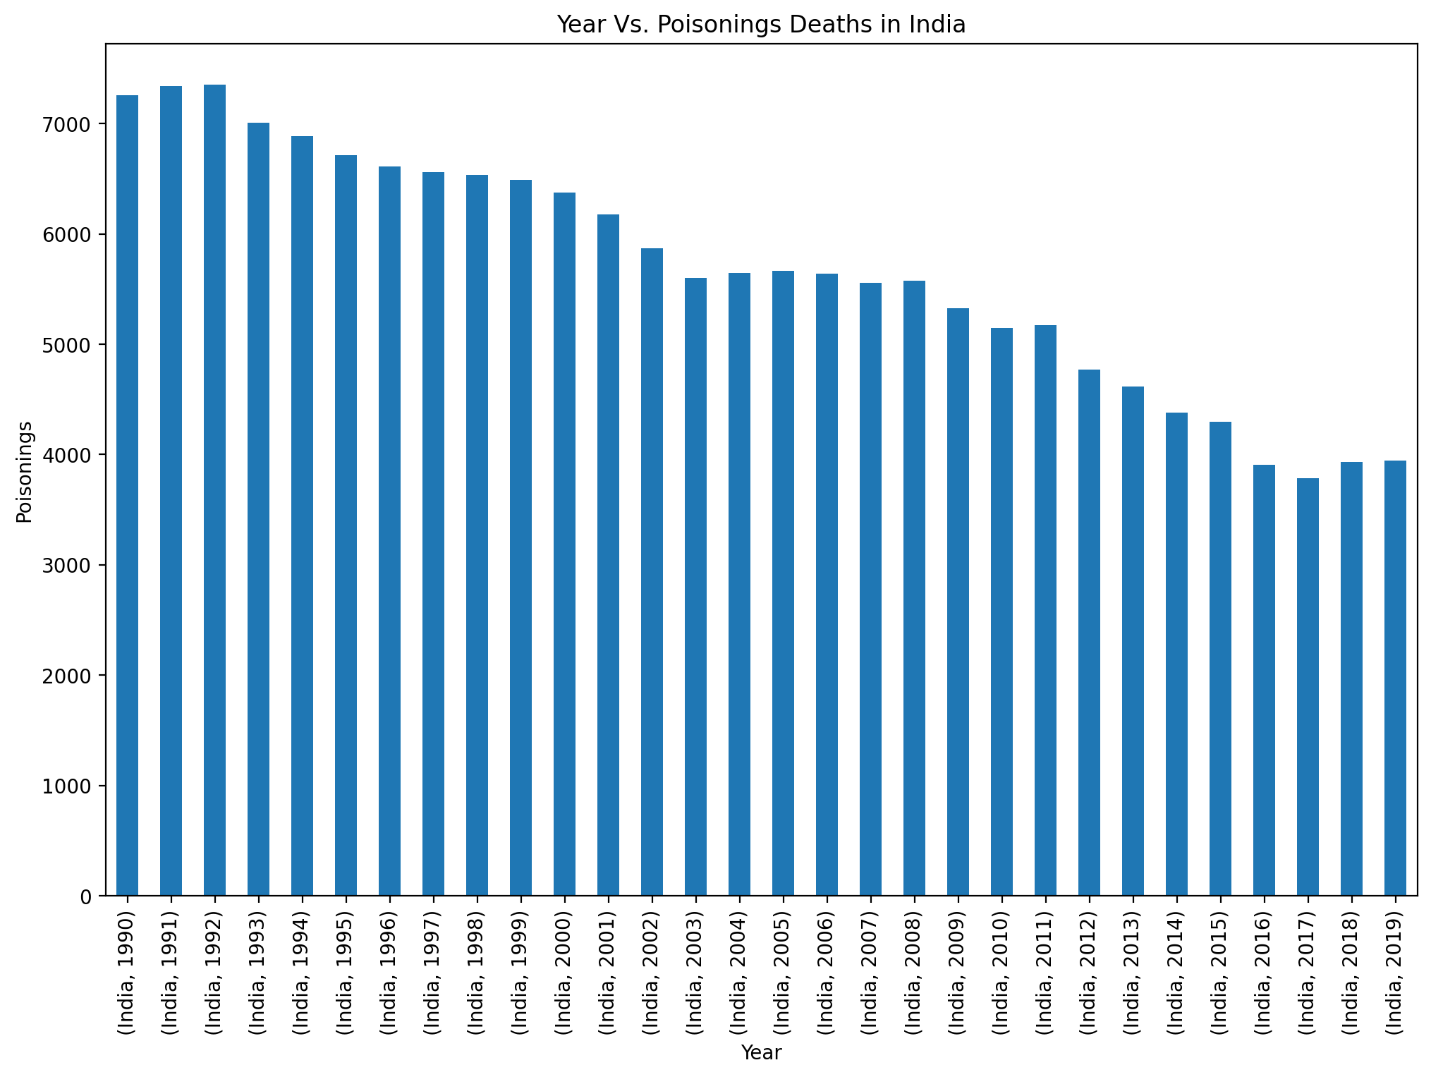
YEAR VS POISININGS DEATHS IN INDIA:
CODE:
plt.figure(figsize=(12,8),dpi=200) china_df = India_Total_no_of_Deaths_df.groupby(['Country/Territory','Year']).sum() china_df['Poisonings'].plot(kind='bar') plt.xlabel("Year") plt.ylabel("Poisonings") plt.title("Year Vs. Poisonings Deaths in India") plt.show();

Slide 40

Year vs protiem energy malnutrition deaths in india:
Code:
plt.figure(figsize=(12,8),dpi=200) china_df = India_Total_no_of_Deaths_df.groupby(['Country/Territory','Year']).sum() china_df['Protein-Energy Malnutrition'].plot(kind='bar') plt.xlabel("Year") plt.ylabel("Protein-Energy Malnutrition") plt.title("Year Vs. Protein-Energy Malnutrition Deaths in India") plt.show();

Slide 41
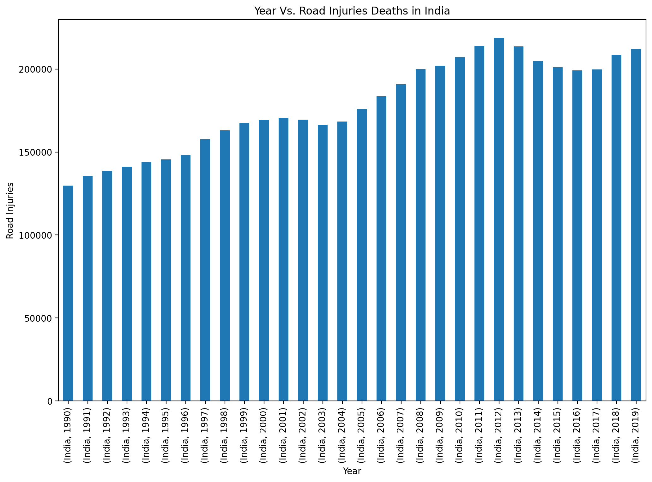
YEAR VS ROAD INJURIES DEATHS IN INDIA:
CODE:
plt.figure(figsize=(12,8),dpi=200) china_df = India_Total_no_of_Deaths_df.groupby(['Country/Territory','Year']).sum() china_df['Road Injuries'].plot(kind='bar') plt.xlabel("Year") plt.ylabel("Road Injuries") plt.title("Year Vs. Road Injuries Deaths in India") plt.show();

Slide 42
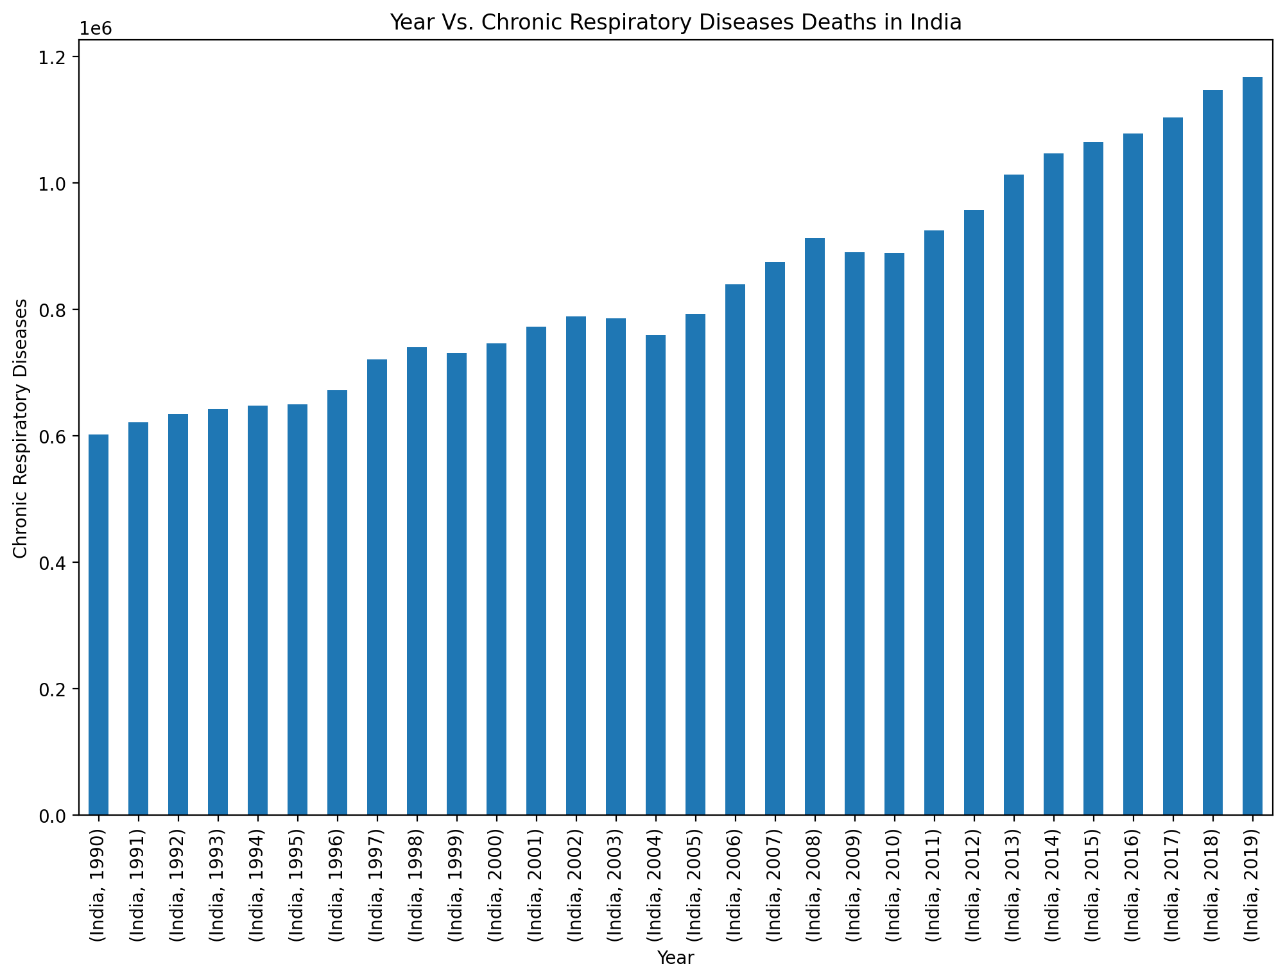
YEAR VS CHRONIC RESPIRATORY DISEASES SEATHS IN INDIA:
CODE:
plt.figure(figsize=(12,8),dpi=200) china_df = India_Total_no_of_Deaths_df.groupby(['Country/Territory','Year']).sum() china_df['Chronic Respiratory Diseases'].plot(kind='bar') plt.xlabel("Year") plt.ylabel("Chronic Respiratory Diseases") plt.title("Year Vs. Chronic Respiratory Diseases Deaths in India") plt.show();

Slide 43
Top 3 Countries interms of "Total no.of Deaths" - For All the Years
CODE:
# Total causes of death across 30 years Countries_Total_no_of_Deaths_noyear_df = df.groupby('Country/Territory').sum() Countries_Total_no_of_Deaths_noyear_df.drop('Year',axis=1,inplace=True)
# Top 3 Countries interms of "Total no.of Deaths" - For All the Years Countries_Total_no_of_Deaths_noyear_df.sort_values(by='Total_no_of_Deaths',ascending =False)[:3]
China - Top 10 Causes of Deaths
china_10 = Countries_Total_no_of_Deaths_noyear_df.sort_values(by='Total_no_of_Deaths',ascending =False)[:1]
china_10.iloc[0].sort_values(ascending=False)[1:11]

Slide 44
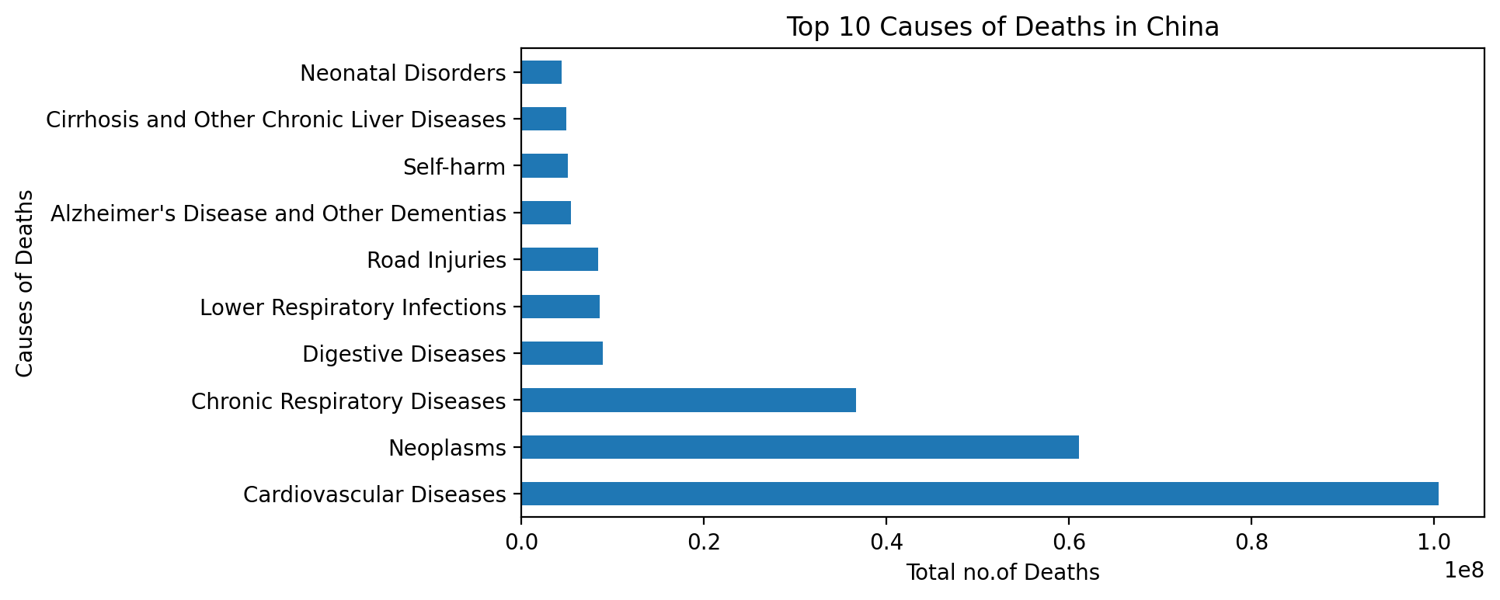
Top 10 Causes deaths in china:
Code:
plt.figure(figsize=(8,4),dpi=200) china_10.iloc[0].sort_values(ascending=False)[1:11].plot(kind='barh') plt.xlabel("Total no.of Deaths") plt.ylabel("Causes of Deaths") plt.title("Top 10 Causes of Deaths in China") plt.show();

Slide 45
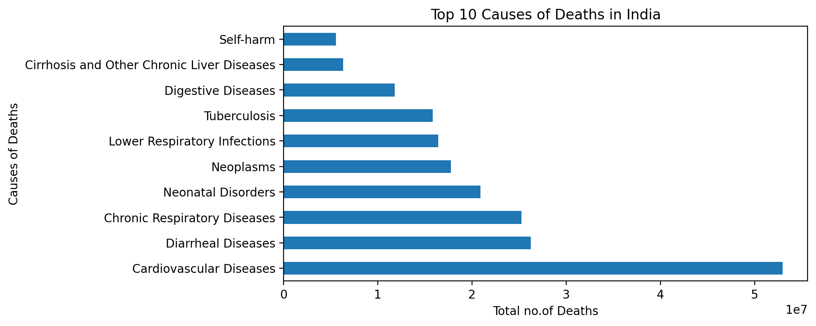
Top 10 Causes of Deaths in india:
Code:
India_10 = Countries_Total_no_of_Deaths_noyear_df.sort_values(by='Total_no_of_Deaths',ascending =False)[1:2]
India_10.iloc[0].sort_values(ascending=False)[1:11]
plt.figure(figsize=(8,4),dpi=200)
CODE:
India_10.iloc[0].sort_values(ascending=False)[1:11].plot(kind='barh') plt.xlabel("Total no.of Deaths") plt.ylabel("Causes of Deaths") plt.title("Top 10 Causes of Deaths in India") plt.show();

Slide 46
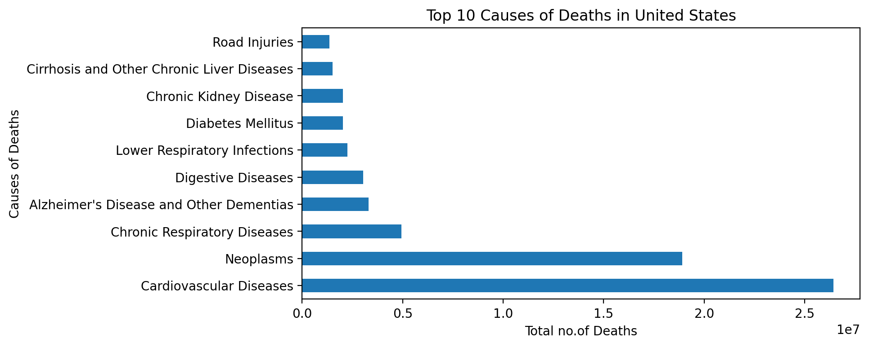
TOP 10 CAUSES OF DEATHS IN UNITED STATES:
usa_10 = Countries_Total_no_of_Deaths_noyear_df.sort_values(by='Total_no_of_Deaths',ascending =False)[2:3]
usa_10.iloc[0].sort_values(ascending=False)[1:11]
CODE: plt.figure(figsize=(8,4),dpi=200) usa_10.iloc[0].sort_values(ascending=False)[1:11].plot(kind='barh') plt.xlabel("Total no.of Deaths") plt.ylabel("Causes of Deaths") plt.title("Top 10 Causes of Deaths in United States") plt.show();

Slide 47
methods----------- CONCLUSIONS:
Dtypes—
Describe—
Length—
Shape—
Null values—
The no.of Year --data in the Dataframe
The unique Year-- data in the Dataframe
Total no.of Countries- in the DataFrame
Total no.of year data provided for each country in the DataFrame
Top 10 Total_no_of_Deaths –
-Int64(32), object(2)
-8 rows × 32 columns
-6120
-(6120, 34)
-No null entries for any column in the Dataframe
-30
-(1990 to 2019, dtype=int64)
- 204
- 30 year data is provided for Each Country in the Data Frame
- From the Above table, the "top 10 - Total_no_of_Deaths" belongs to 'China' and the "top 60 - Total_no_of_Deaths" belongs to 'China' and 'India' combined, followed by 'USA' and 'Russia'. This because of the fact "China" and "India" are the countries that stand in top 2 interms of population.

Slide 48
China –causes of death(figures conclusions-using barplot,scatterplot)
Year Vs. Total no.of Deaths for -China
Year Vs. Malaria Deaths in china
Year Vs. Nutritional Deficiencies Deaths in china
Year Vs. Interpersonal Violence Deaths in china
Year Vs. Maternal Disorders Deaths in china
Year Vs. HIV/AIDS Deaths in china
Year Vs. Tuberculosis Deaths in china
- -There is a clear raise in Total No.of Deaths recorded with each year for China.Common Causes of Death:
There is a rapid drop in Malaria Deaths recorded in China after 1999.
There is a drop in Nutritional Deficiencies Deaths recorded in China in 2007 and from 2008 the count of deaths again started to raise.
There is a continual drop in Interpersonal Violence Deaths recorded in China.
There is a continual drop in Maternal Disorder Deaths recorded in China after year 1998.
There is a continual increase in HIV/AIDS Deaths recorded in China.
There is a continual decrease in Tuberculosis Deaths recorded in China.

Slide 49
CAUSES OF DEATH :Figures--------CONCLUSIONS:
Year Vs. Cardiovascular Diseases Deaths in china
Year Vs. Self-harm Deaths in china
Year Vs. Exposure to Forces of Nature Deaths in china
Year Vs. Conflict and Terrorism Deaths in china
Year Vs. Poisonings Deaths in china
Year Vs. Protein-Energy Malnutrition Deaths in china
Year Vs. Road Injuries Deaths in china
Year Vs. Chronic Respiratory Diseases Deaths in china
There is a continual increase in Cardiovascular Diseases Deaths recorded in China.
There is a continual drop in Self-harm Deaths recorded in China after year 2004.
There is a rapid raise in Exposure to Forces of Nature Deaths recorded in China in the year 2004 this is because of Sichuan earthquake of 2008.
The terrorist attack of 2014 is at Kunming Railway Station in Kunming, Yunnan, China on March 1st.
There is a continual raise in Poisonings Deaths recorded in China after year 1994.
There is a continual raise in Protein-Energy Malnutrition Deaths recorded in China after year 2007.
There is a continual drop in Road Injuries Deaths recorded in China after year 2009.
There is a continual drop in Chronic Respiratory Diseases Deaths recorded in China after year 2004.

Slide 50
India- causes of death(figures conclusions-using barplot,scatterplot)
Year Vs. Total no.of Deaths for -India
Year Vs. Malaria Deaths in India
Year Vs. Nutritional Deficiencies Deaths in India
Year Vs. Interpersonal Violence Deaths in India
Year Vs. Maternal Disorders Deaths in India
Year Vs. HIV/AIDS Deaths in India
Year Vs. Tuberculosis Deaths in India
Overall there is a raise in Total No.of Deaths recorded with each year for India, even though there are fluctuations inbetween.
There is a rapid drop in Malaria Deaths recorded in India from 1990, but the Deaths in 2018 and 2019 is greater than that of 2016 and 2017.
There is a continual drop in Nutritional Deficiencies Deaths recorded in India from 1990.
There is a raise in Interpersonal Violence Deaths recorded in India from 2014.
There is continual drop in Maternal Disorders Deaths recorded in India after 1999.
There is continual raise in HIV/AIDS Deaths recorded in India from 1992 and reached peak at 2006 from where there is continual drop.
Though there are deviations in Tuberculosis Deaths recorded in India, there is a drop after year 1998

Slide 51
causes of death(figures conclusions
Year Vs. Cardiovascular Diseases Deaths in India
Year Vs. Self-harm Deaths in India
Year Vs. Exposure to Forces of Nature Deaths in India
Year Vs. Conflict and Terrorism Deaths in India
Year Vs. Poisonings Deaths in India
Year Vs. Protein-Energy Malnutrition Deaths in India
Year Vs. Road Injuries Deaths in India
Year Vs. Chronic Respiratory Diseases Deaths in India
There are continual raise in Cardiovascular Diseases Deaths recorded in India.
There are continual raise in Self-harm Deaths recorded in India from 1990 to 2001, but then there are fluctuations.
The Peak incident: Bhachau Taluka of Kutch (Gujarat) experienced an earthquake of 7.6 to 7.9 on the Richter Scale and lasted for 120 seconds. This disaster killed around 20,000, injured 167,000 and nearly 400,000 people became homeless.The 2013 incident: The year 2013 witnessed two major events, the Uttarakhand Flash Floods, mainly affecting the state of Uttarakhand and the Cyclone “Phailin” affecting two coastal states of Odisha and Andhra Pradesh.
Overall there is a gradual decrease in the Poisonings Deaths recorded in India.
There is a continual drop in the Protein-Energy Malnutrition Deaths recorded in India.
There is a continual raise in the Road Injuries Deaths recorded in India with fluctuations between 2013 to 2017.
There is a continual raise in the Chronic Respiratory Diseases Deaths recorded in India with mere fluctuations inbetween.

Slide 52
Top 3 Countries interms of "Total no.of Deaths" - For All the Years(CONCLUSIONS)
Top 10 Causes of Deaths in China
Top 10 Causes of Deaths in India
Top 10 Causes of Deaths in United States
-Here we can see lowest causes of death is Neonatal Disorders and highest causes of death is Cardiovascular diseases.India – Top 10 Causes of Deaths.
-Here we can see lowest causes of death is Self-harm and highest causes of death is Cardiovascular diseases.United States - Top 10 Causes of Deaths
-Here we can see lowest causes of death is road injuries and highest causes of death is Cardiovascular diseases.

Slide 53
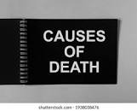
End of the project - > Causes of death:
FlipRobo - -
Technologies - -
PROJECT – SUBMITTED BY - -
- - Jyoti Chaudhary

